Slide 1
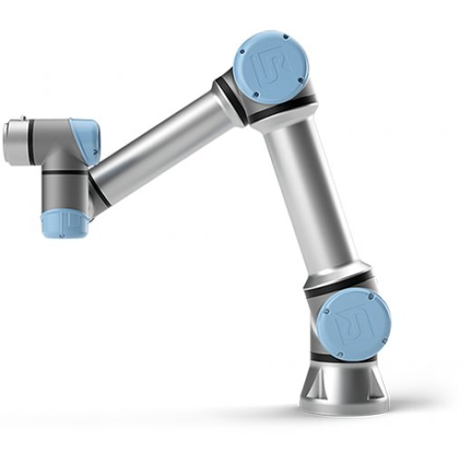
Tavola 1
Control on non-linear system

Slide 2
Summary
Brief presentation of the UR5 model and reference frames
Computed torque control
Backstepping control
Adaptive control:
Adaptive backstepping
Li-Slotine

Slide 3
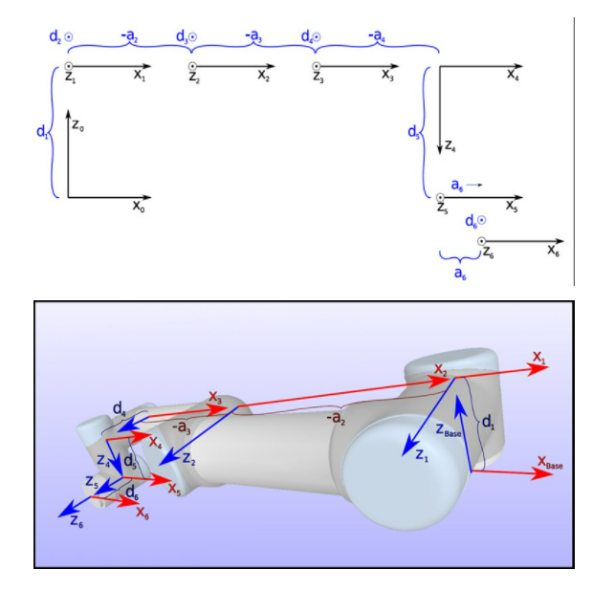
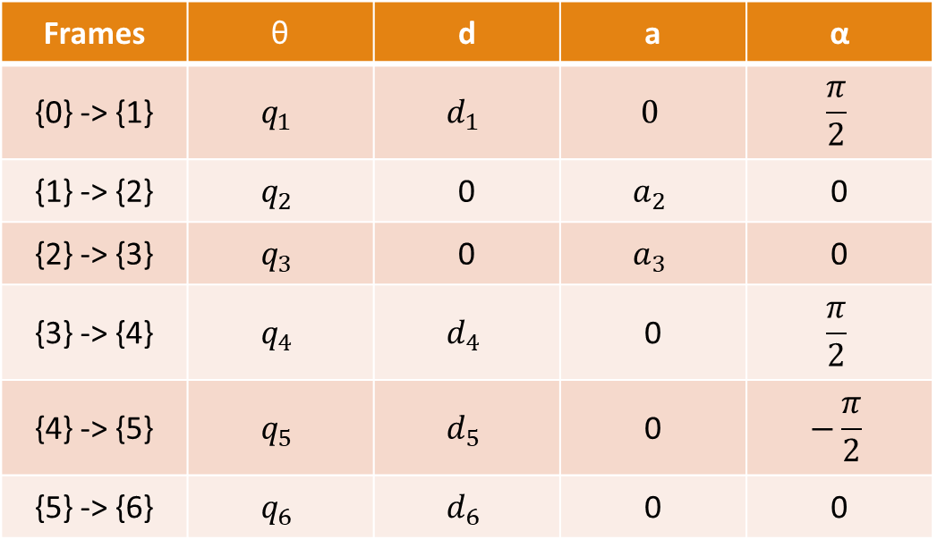
UR5 - Denavit-Hartenberg
Frames | θ | d | a | α
{0} -> {1} | $$q_{1}$$ | $$d_{1}$$ | $$0$$ | $$\frac{π}{2}$$
{1} -> {2} | $$q_{2}$$ | 0 | $$a_{2}$$ | 0
{2} -> {3} | $$q_{3}$$ | 0 | $$a_{3}$$ | 0
{3} -> {4} | $$q_{4}$$ | $$d_{4}$$ | 0 | $$\frac{π}{2}$$
{4} -> {5} | $$q_{5}$$ | $$d_{5}$$ | 0 | $$−\frac{π}{2}$$
{5} -> {6} | $$q_{6}$$ | $$d_{6}$$ | 0 | 0

Slide 4
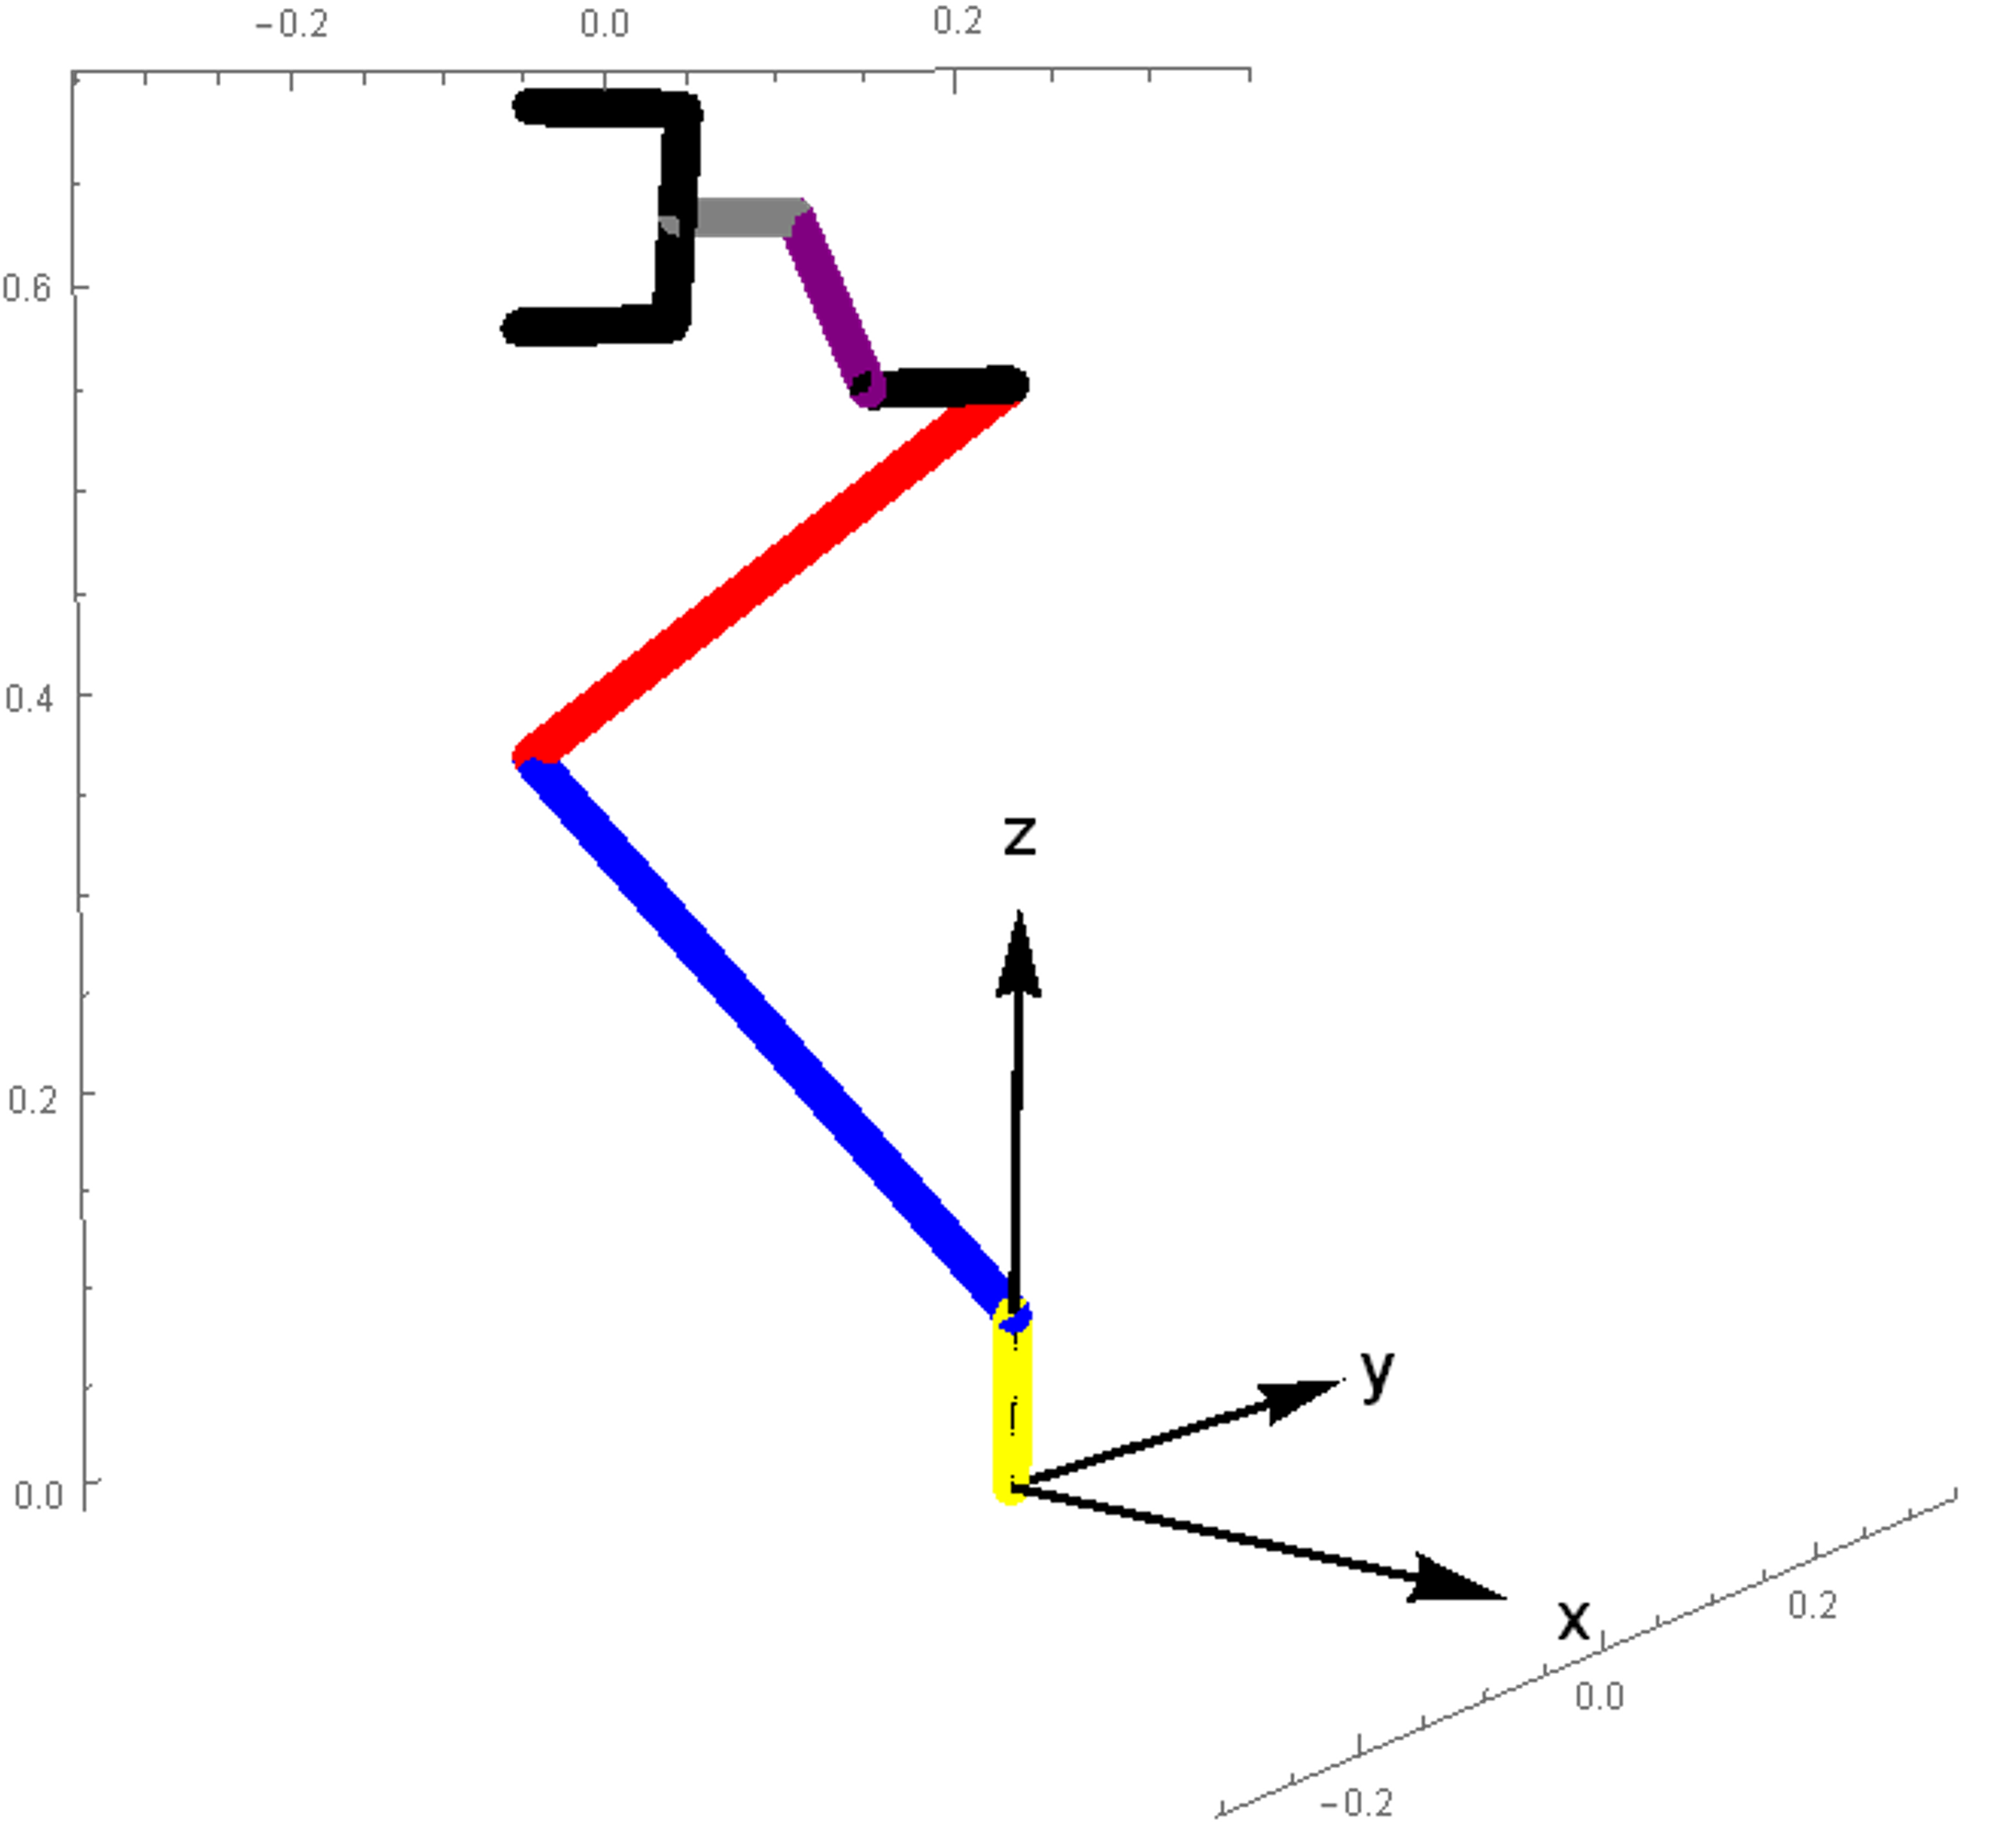
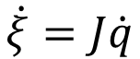
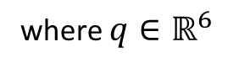
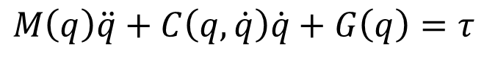
Dynamics and Kinematics
$$M\left(q\right)\ddot{q}+C\left(q,\dot{q}\right)\dot{q}+G\left(q\right)=τ$$
$$\dot{ξ}=J\dot{q}$$
where $q∈{\text{ℝ}}^{6}$
Initial conditions for every control type:
$$q\left(0\right)={(0°, −37°, −110°, −2.5°, −1°, 55°)}^{T}$$

Slide 5
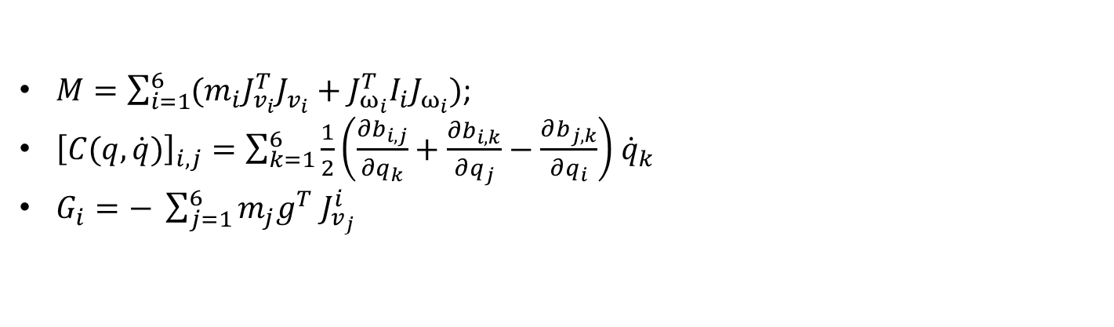
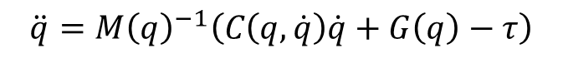
Model Implementation
$$\ddot{q}={M\left(q\right)}^{−1}\left(C\left(q,\dot{q}\right)\dot{q}+G\left(q\right)−τ\right)$$
$M=\sum_{i=1}^{6}{(m_{i}J_{v_{i}}^{T}J_{v_{i}}+J_{ω_{i}}^{T}I_{i}J_{ω_{i}})}$;
${\left[C(q,\dot{q})\right]}_{i,j}=\sum_{k=1}^{6}{\frac{1}{2}\left(\frac{∂b_{i,j}}{∂q_{k}}+\frac{∂b_{i,k}}{∂q_{j}}−\frac{∂b_{j,k}}{∂q_{i}}\right){ \dot{q}}_{k}}$
$G_{i}=− \sum_{j=1}^{6}{m_{j}g^{T} J_{v_{j}}^{i}}$
P.I. Corke, Robotics, Vision & Control: Fundamental Algorithms in MATLAB.
Second edition. Springer, 2017. ISBN 978-3-319-54413-7.

Slide 6
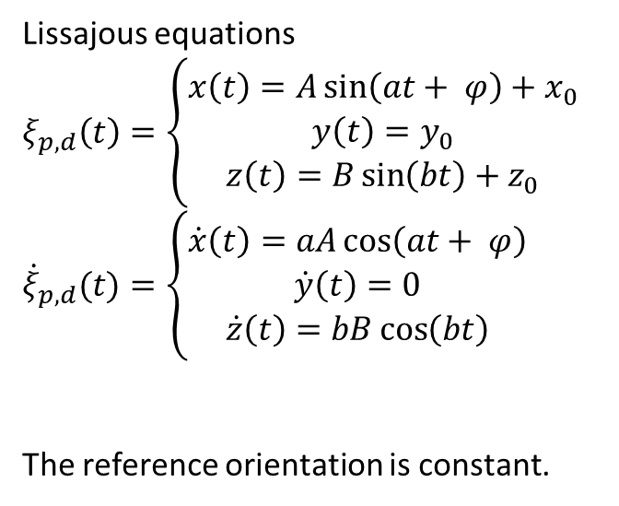
Reference Trajectory - Lissajous
Lissajous equations
$$ξ_{p,d}\left(t\right)=\left\{\begin{aligned}x\left(t\right)=A\sin\left(at+ φ\right)+x_{0} \\ y\left(t\right)=y_{0} \\ z\left(t\right)=B\sin\left(bt\right)+z_{0}\end{aligned}\right.$$
$${\dot{ξ}}_{p,d}(t)=\left\{\begin{aligned}\dot{x}\left(t\right)=aA\cos\left(at+ φ\right) \\ \dot{y}\left(t\right)=0 \\ \dot{z}\left(t\right)=bB\cos\left(bt\right)\end{aligned}\right.$$
The reference orientation is constant.

Slide 7
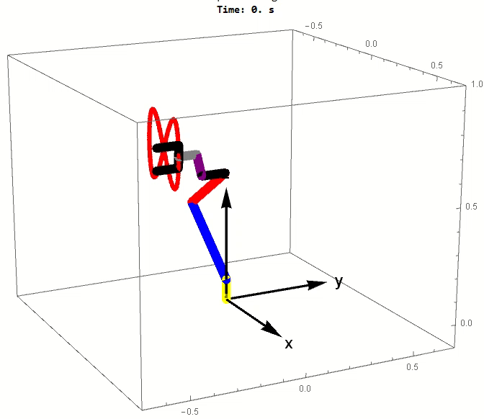
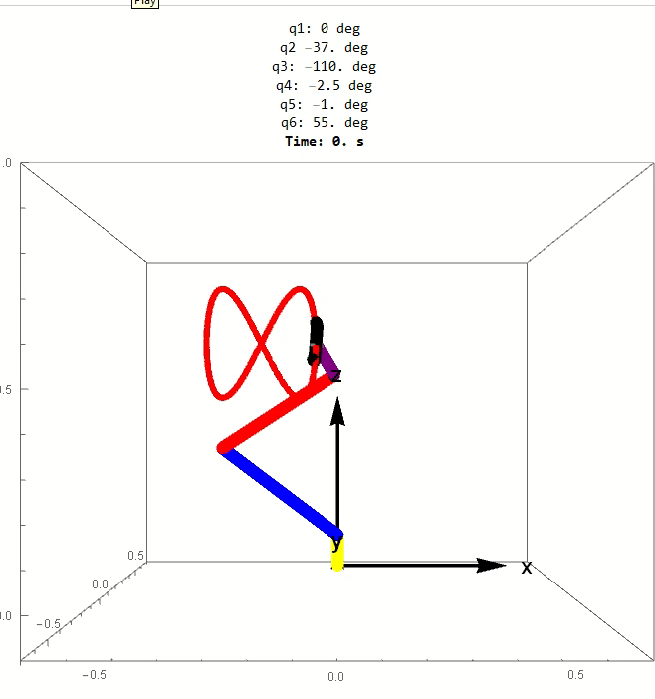

Reference Trajectory - 1
Lissajous equations
With $a=1,b=2$ and $φ=\frac{π}{2}$

Slide 8
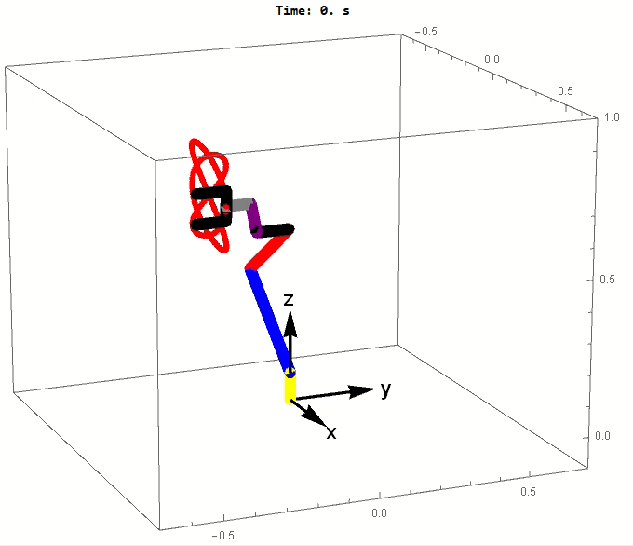
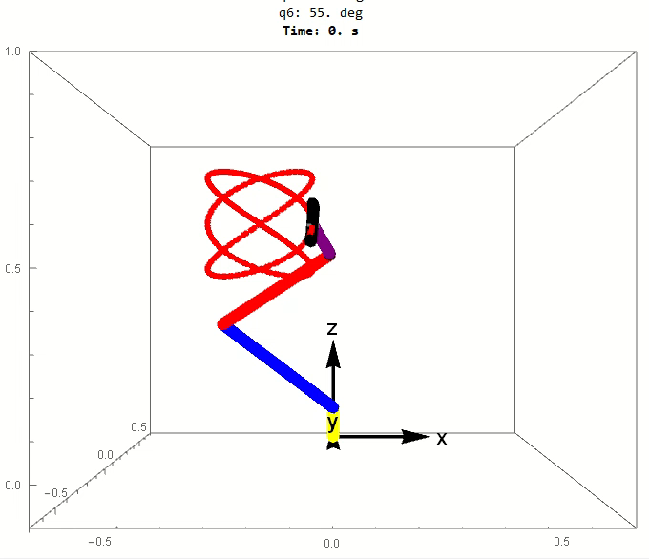

Reference Trajectory - 2
Lissajous equations
With $a=3, b=2$ and $φ=\frac{π}{2}$

Slide 9
Changing Initial Conditions
Our goal is to follow the Lissajous trajectory.
If the initial pose of the robot doesn’t belong to the Lissajous trajectory, the robot will reach the initial point of the trajectory with another trajectory.
Therefore, if the initial conditions are far away, we can consider two problems:
Following the trajectory to reach the initial condition
Following the Lissajous trajectory
We want to show that following one or more trajectories doesn’t change the activity of the controller, but following just one trajectory takes less time.
Therefore we will start from the initial point of the Lissajous trajectory and we will see an example of the composite trajectory at the end of the presentation.

Slide 10
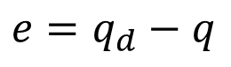
Computed Torque Control
$$τ\left(q,\dot{q},e,\dot{e}\right)=M\left(q\right){\ddot{q}}_{d}+C\left(q,\dot{q}\right)\dot{q}+G\left(q\right)+K_{p}^{′}e+K_{v}′\dot{e}$$
With
$$e=q_{d}−q$$

Slide 11
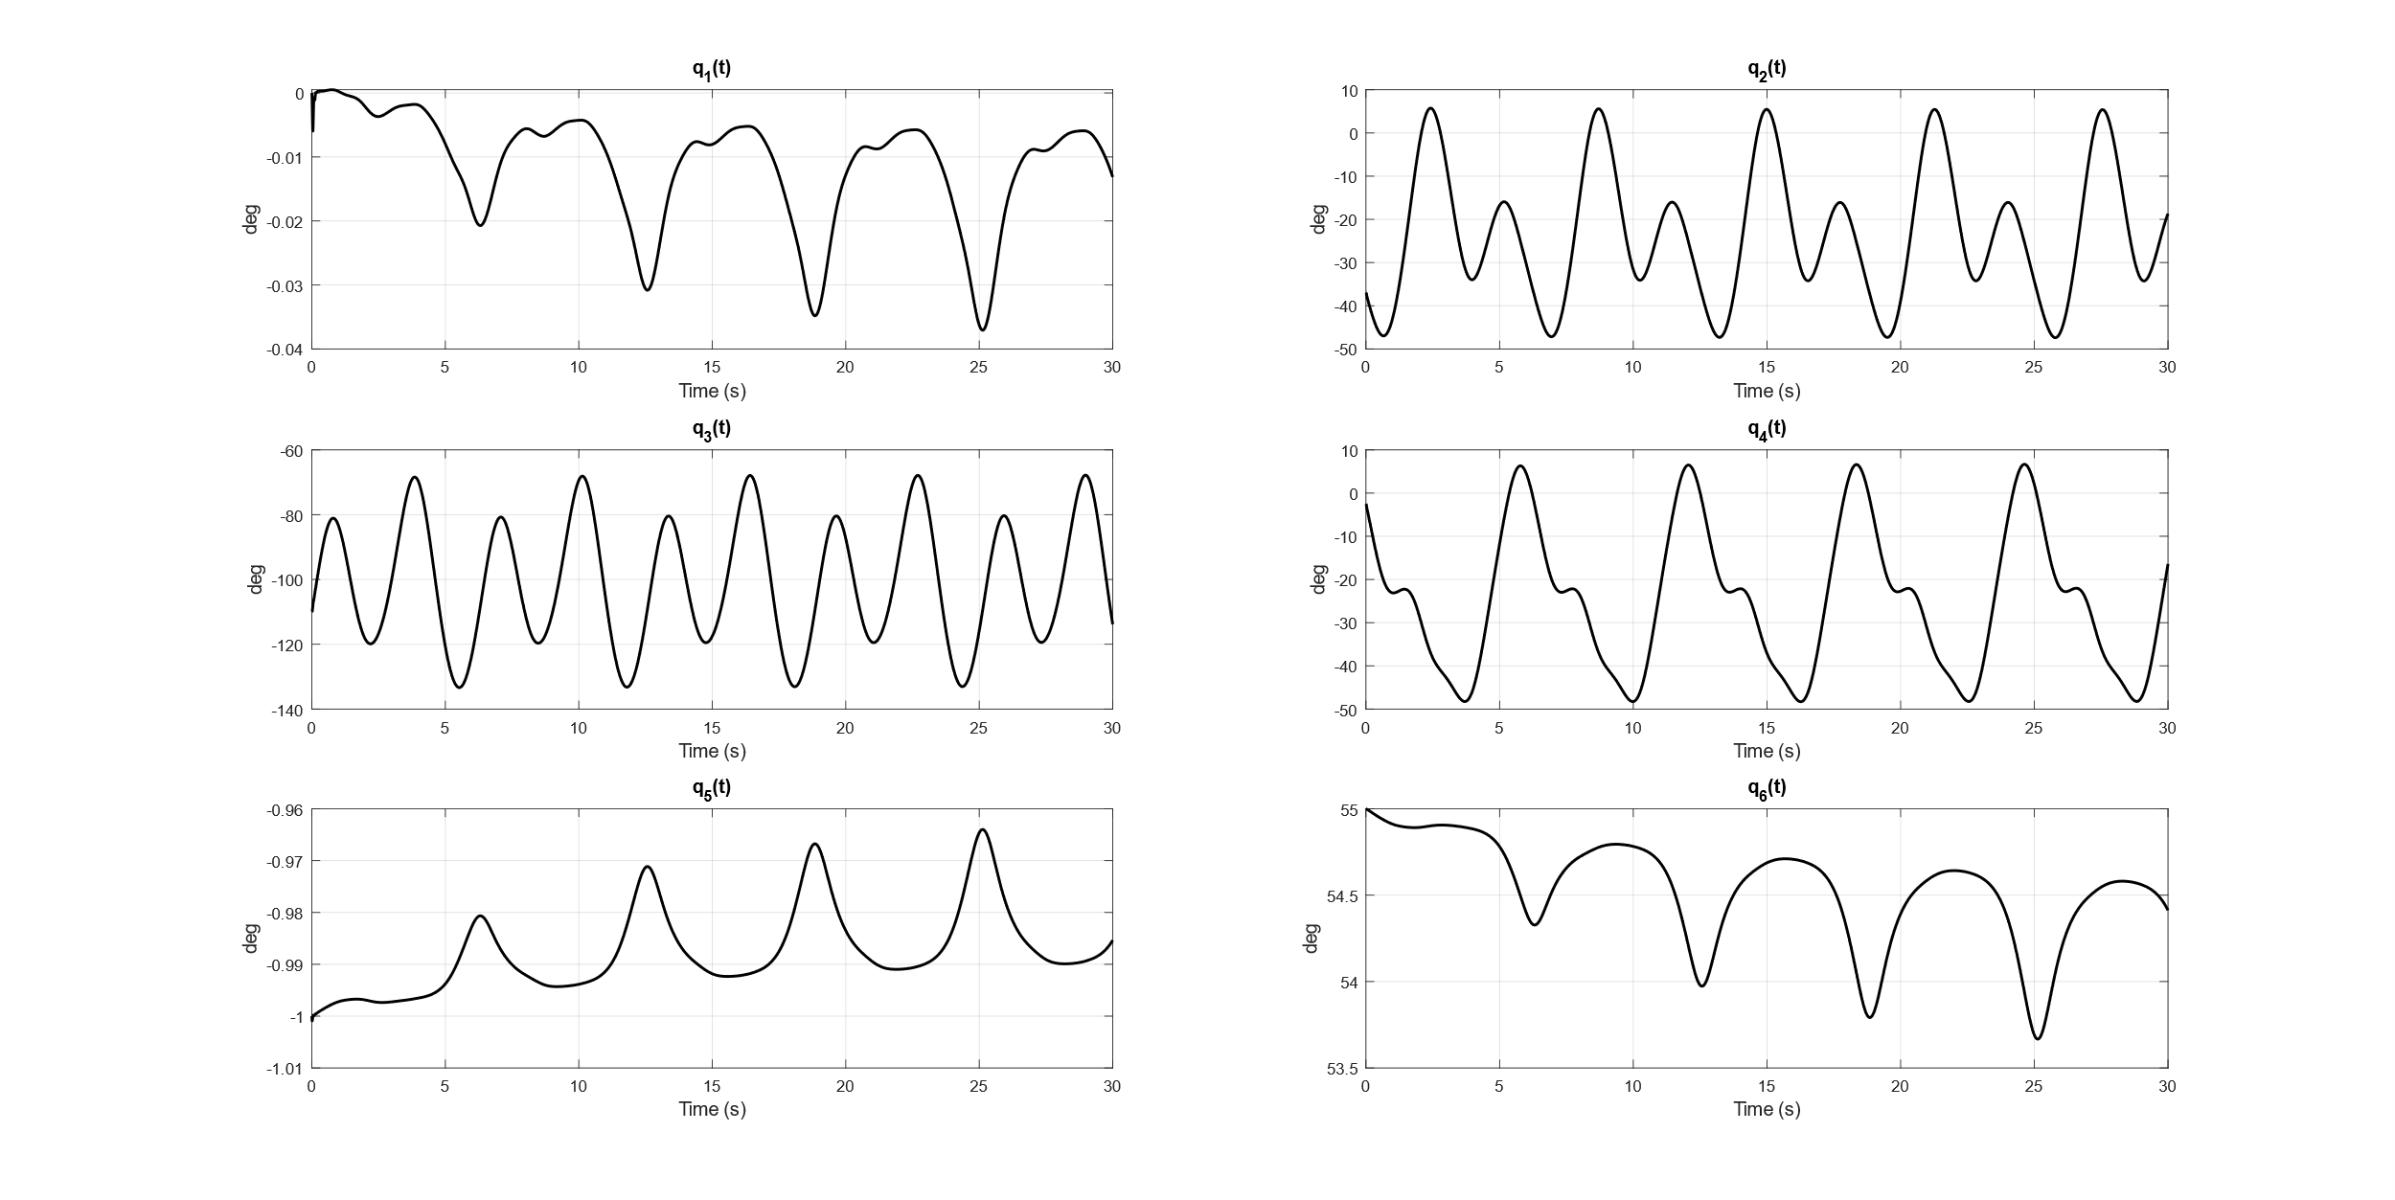
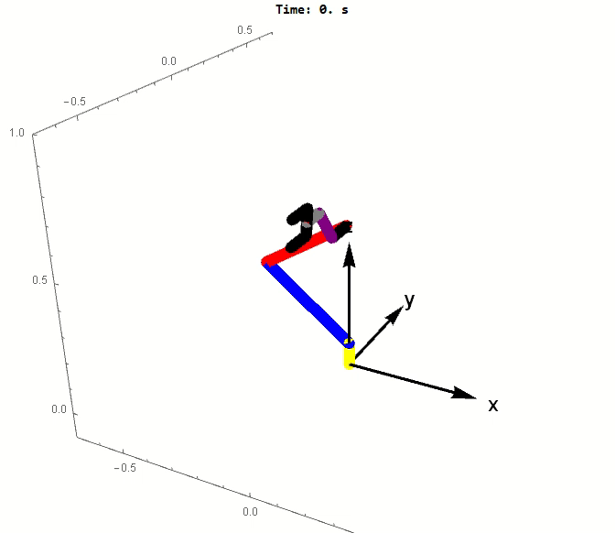
Computed Torque - Results

Slide 12
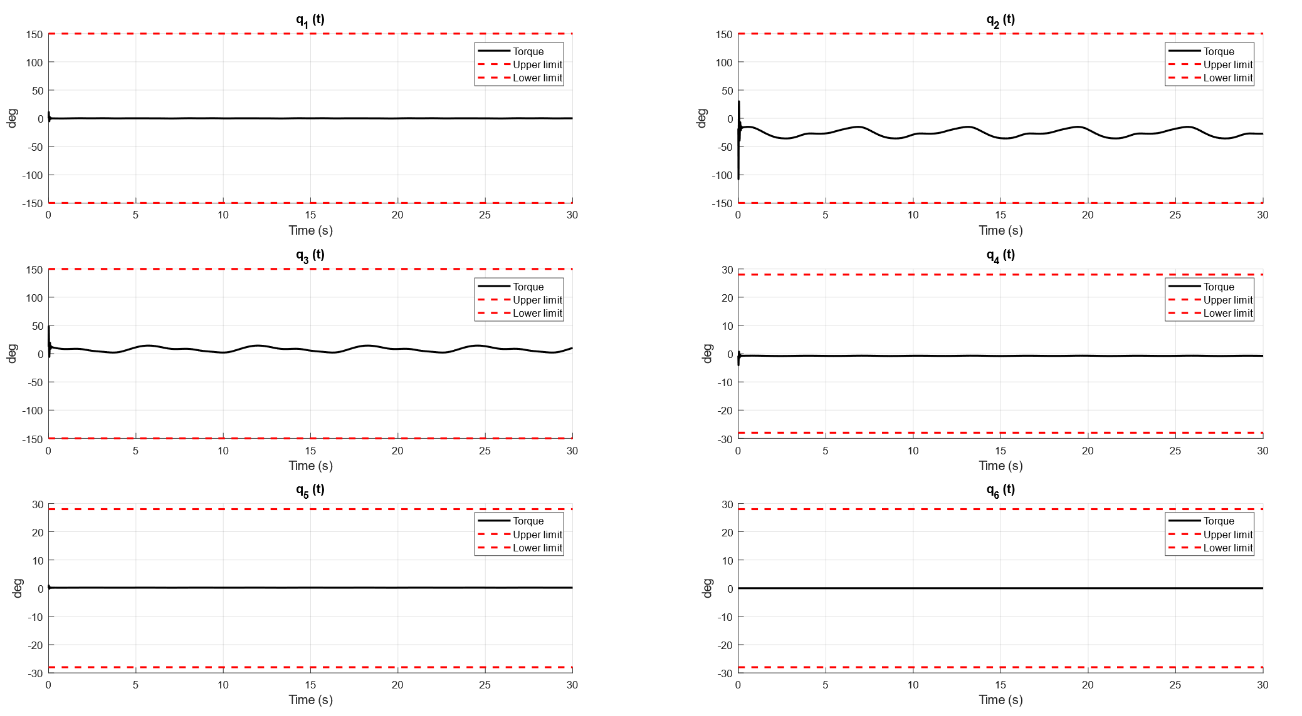
Computed Torque - Torques

Slide 13
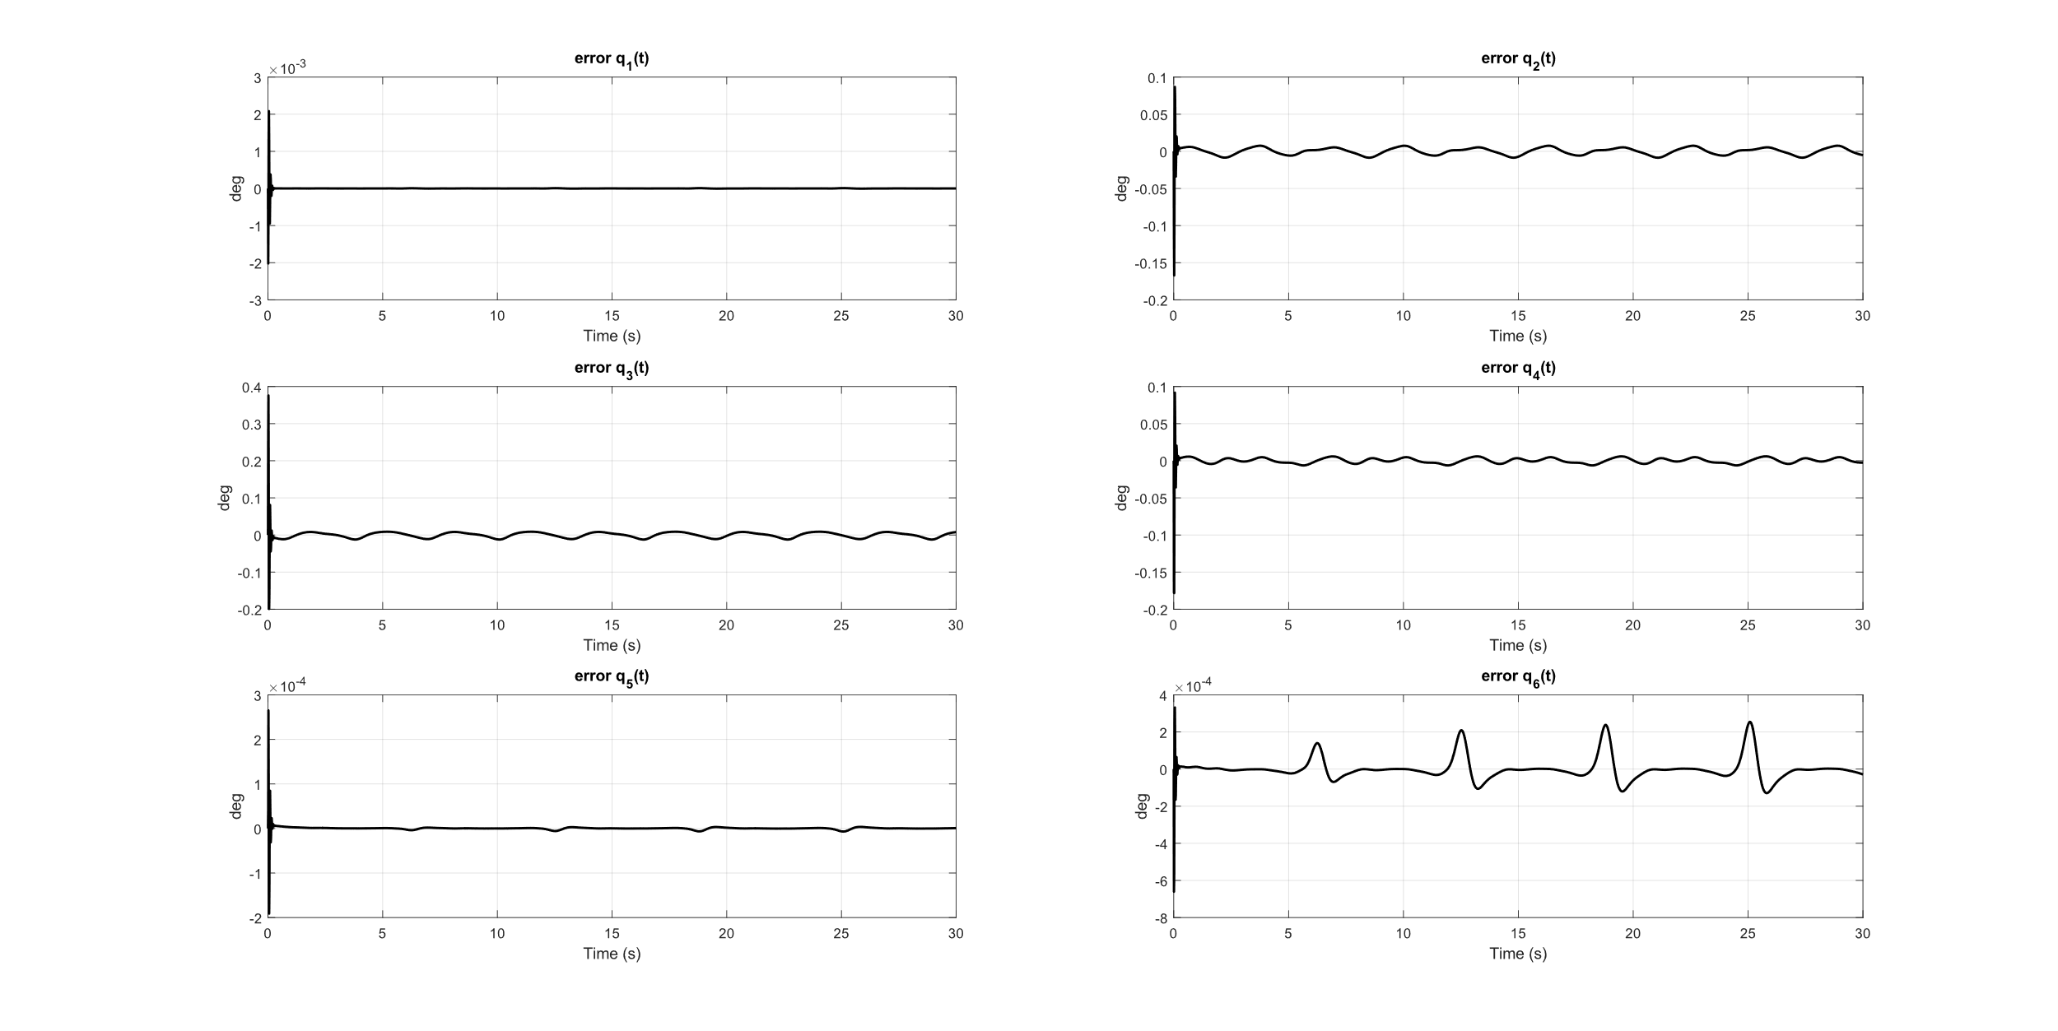
Computed Torque - Tracking Errors

Slide 14
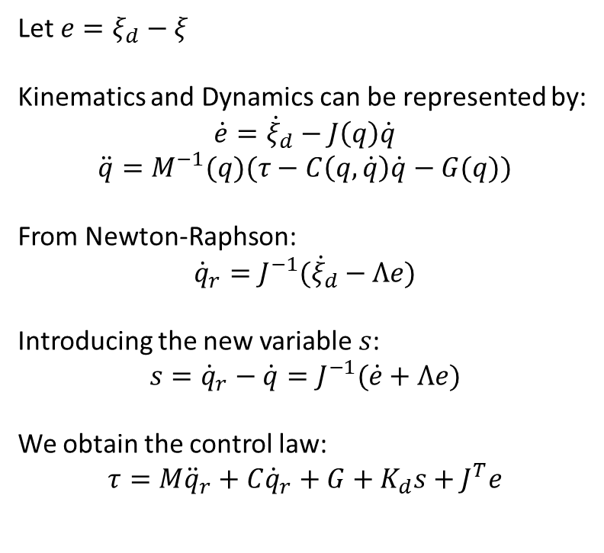
Backstepping
Let $e=ξ_{d}−ξ$
Kinematics and Dynamics can be represented by:
$$\dot{e}={\dot{ξ}}_{d}−J\left(q\right)\dot{q}$$
$$\ddot{q}=M^{−1}(q)(τ−C\left(q,\dot{q}\right)\dot{q}−G(q))$$
From Newton-Raphson:
$${\dot{q}}_{r}=J^{−1}({\dot{ξ}}_{d}−Λe)$$
Introducing the new variable $s$:
$$s={\dot{q}}_{r}−\dot{q}=J^{−1}(\dot{e}+Λe)$$
We obtain the control law:
$$τ=M{\ddot{q}}_{r}+C{\dot{q}}_{r}+G+K_{d}s+J^{T}e$$

Slide 15
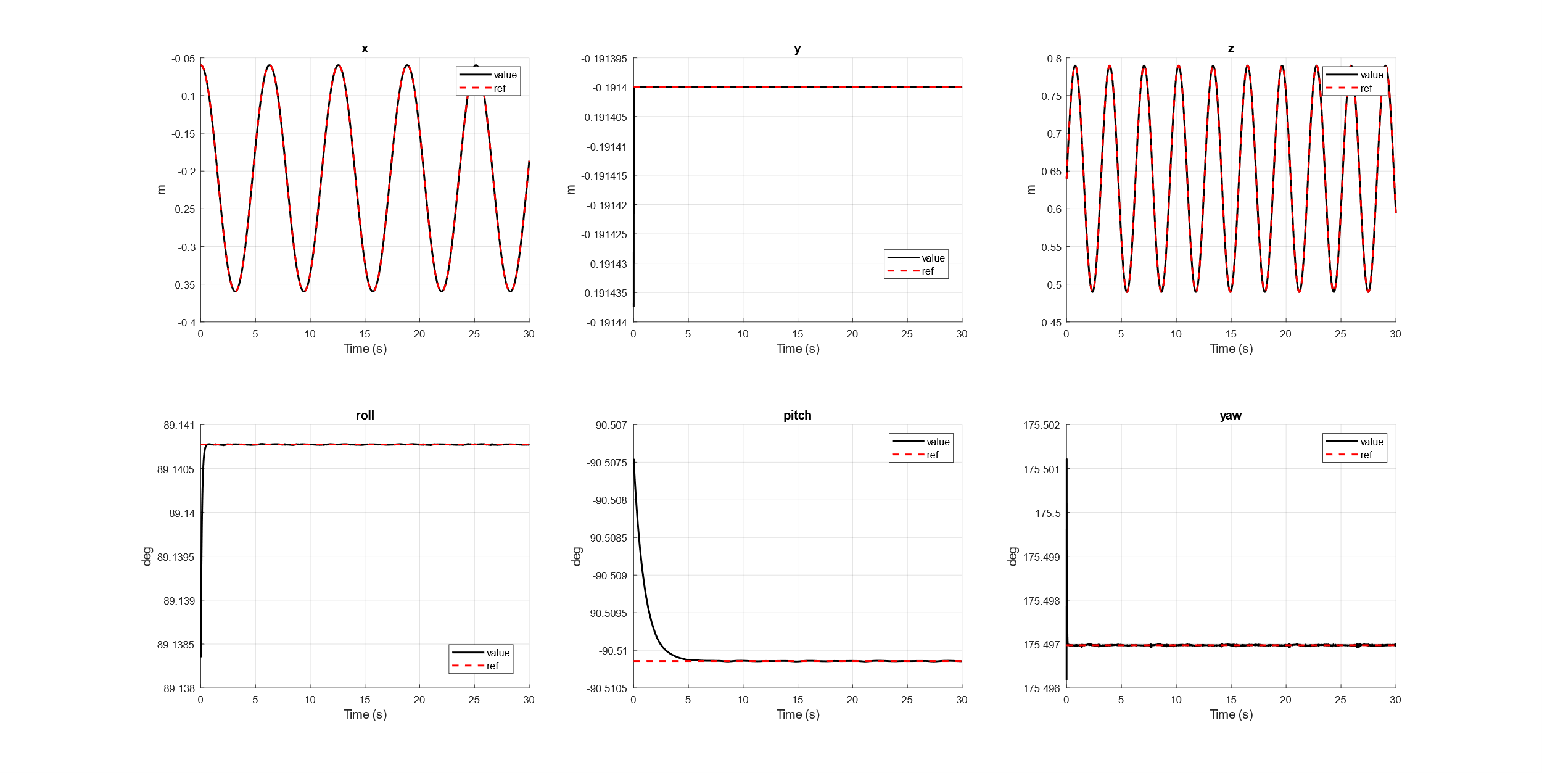
Backstepping - Results

Slide 16
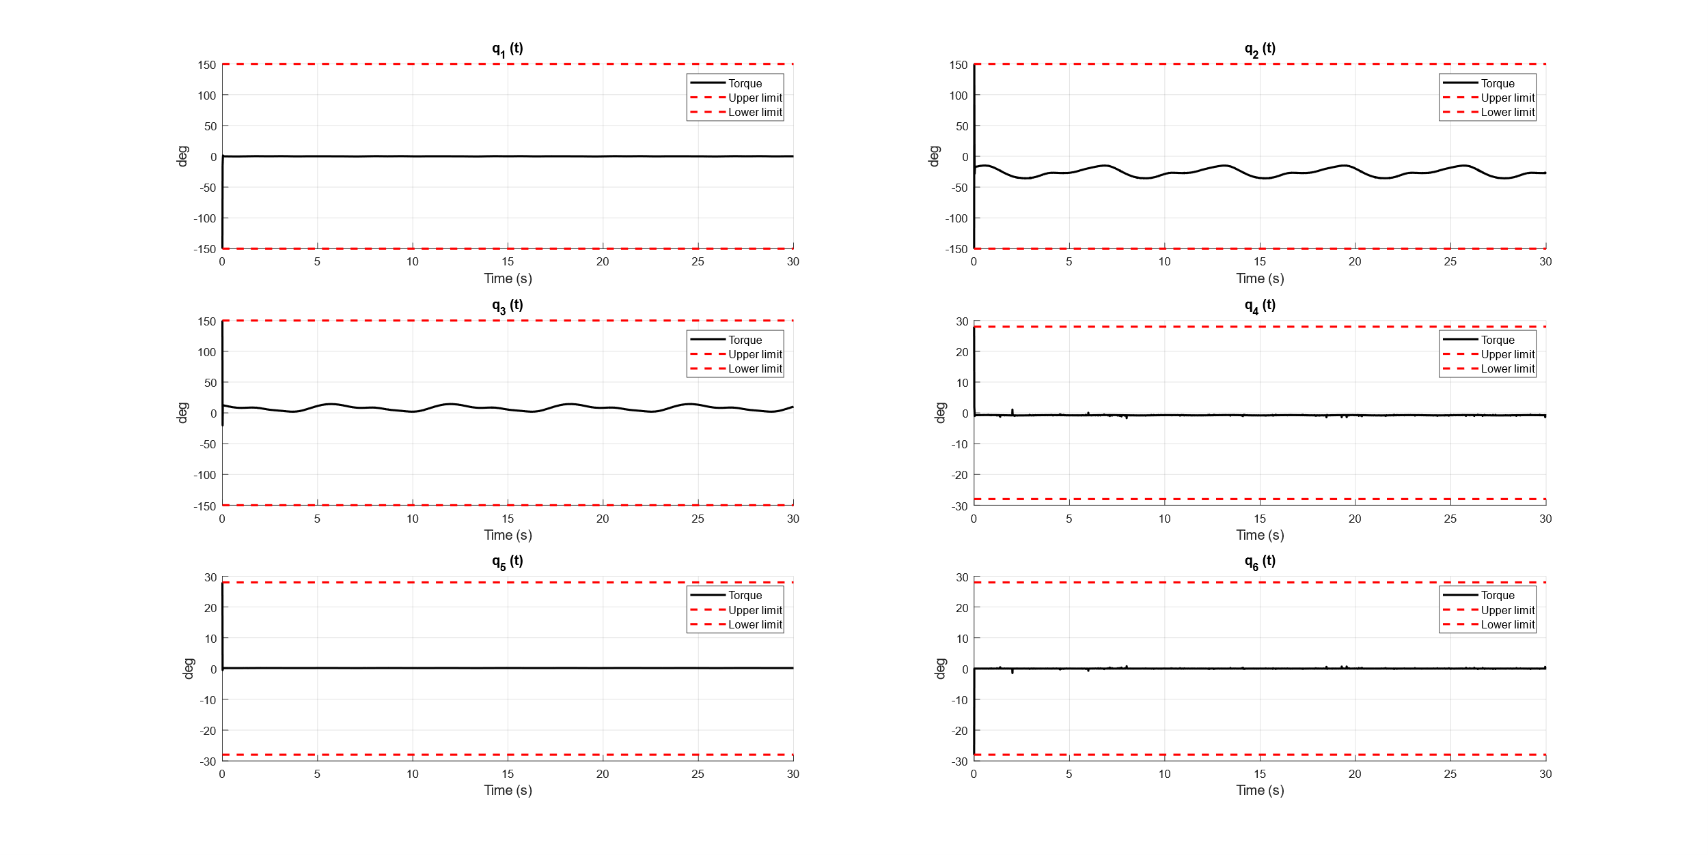
Backstepping - Torques

Slide 17
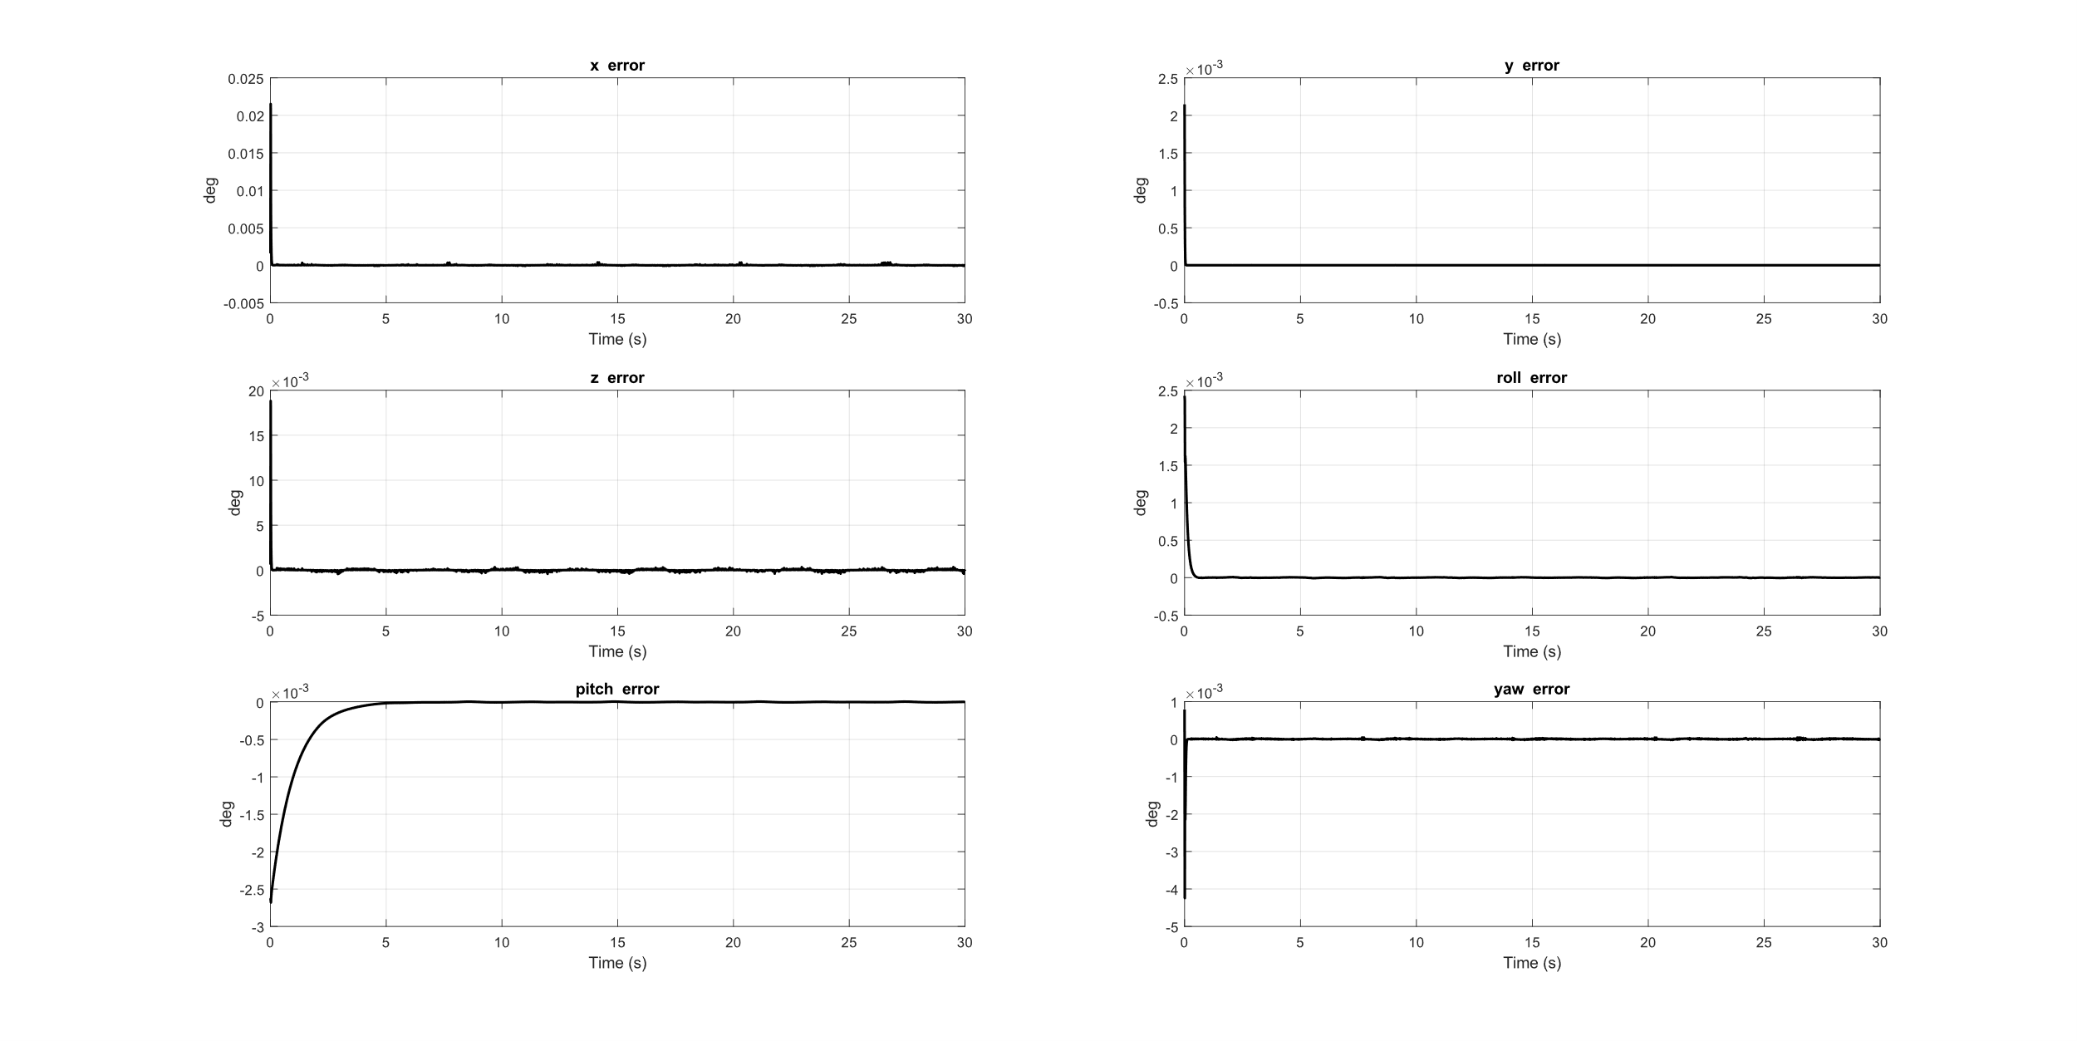
Backstepping -Tracking Errors

Slide 18
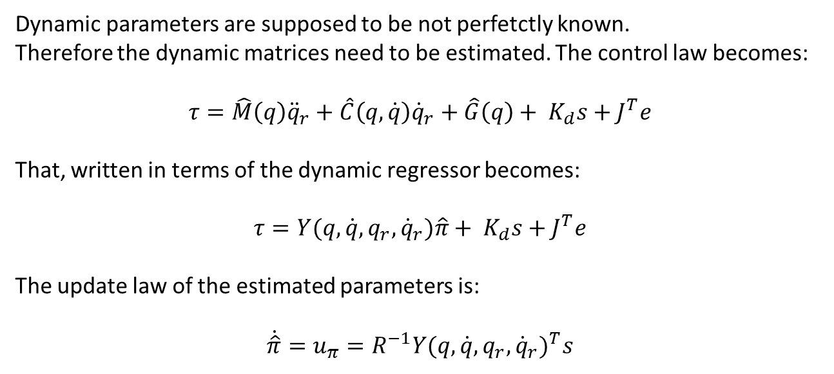
Adaptive Backstepping
Dynamic parameters are supposed to be not perfetctly known.
Therefore the dynamic matrices need to be estimated. The control law becomes:
$$τ=\hat{M}\left(q\right){\ddot{q}}_{r}+\hat{C}\left(q,\dot{q}\right){\dot{q}}_{r}+\hat{G}\left(q\right)+ K_{d}s+J^{T}e$$
That, written in terms of the dynamic regressor becomes:
$$τ=Y(q,\dot{q},q_{r},{\dot{q}}_{r})\hat{π}+ K_{d}s+J^{T}e$$
The update law of the estimated parameters is:
$$\dot{\hat{π}}=u_{π}=R^{−1}{Y(q,\dot{q},q_{r},{\dot{q}}_{r})}^{T}s$$

Slide 19
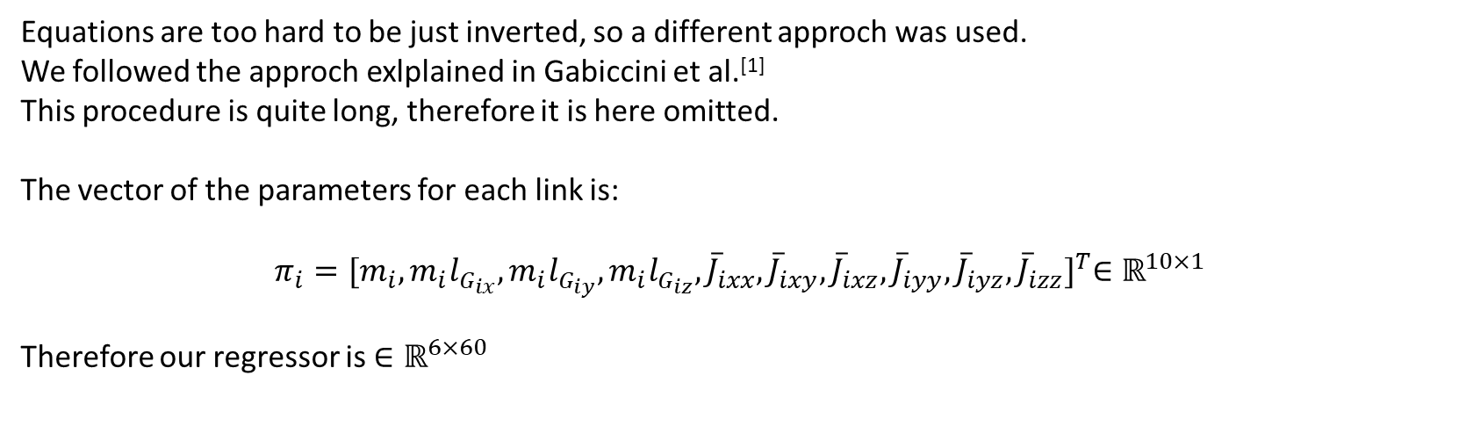
Regressor
Equations are too hard to be just inverted, so a different approch was used.
We followed the approch exlplained in Gabiccini et al.^{[1]}
This procedure is quite long, therefore it is here omitted.
The vector of the parameters for each link is:
$$π_{i}={[m_{i},m_{i}l_{G_{ix}}, m_{i}l_{G_{iy}},m_{i}l_{G_{iz}},{\overline{J}}_{ixx},{\overline{J}}_{ixy},{\overline{J}}_{ixz},{\overline{J}}_{iyy},{\overline{J}}_{iyz},{\overline{J}}_{izz}]}^{T}∈{\text{ℝ}}^{10×1}$$
Therefore our regressor is $∈{\text{ℝ}}^{6×60}$
^{[1]} Gabiccini, Marco, et al. "Explicit Lagrangian formulation of the dynamic regressors for serial manipulators." Proceedings of the XIX Aimeta Congress. 2009.

Slide 20
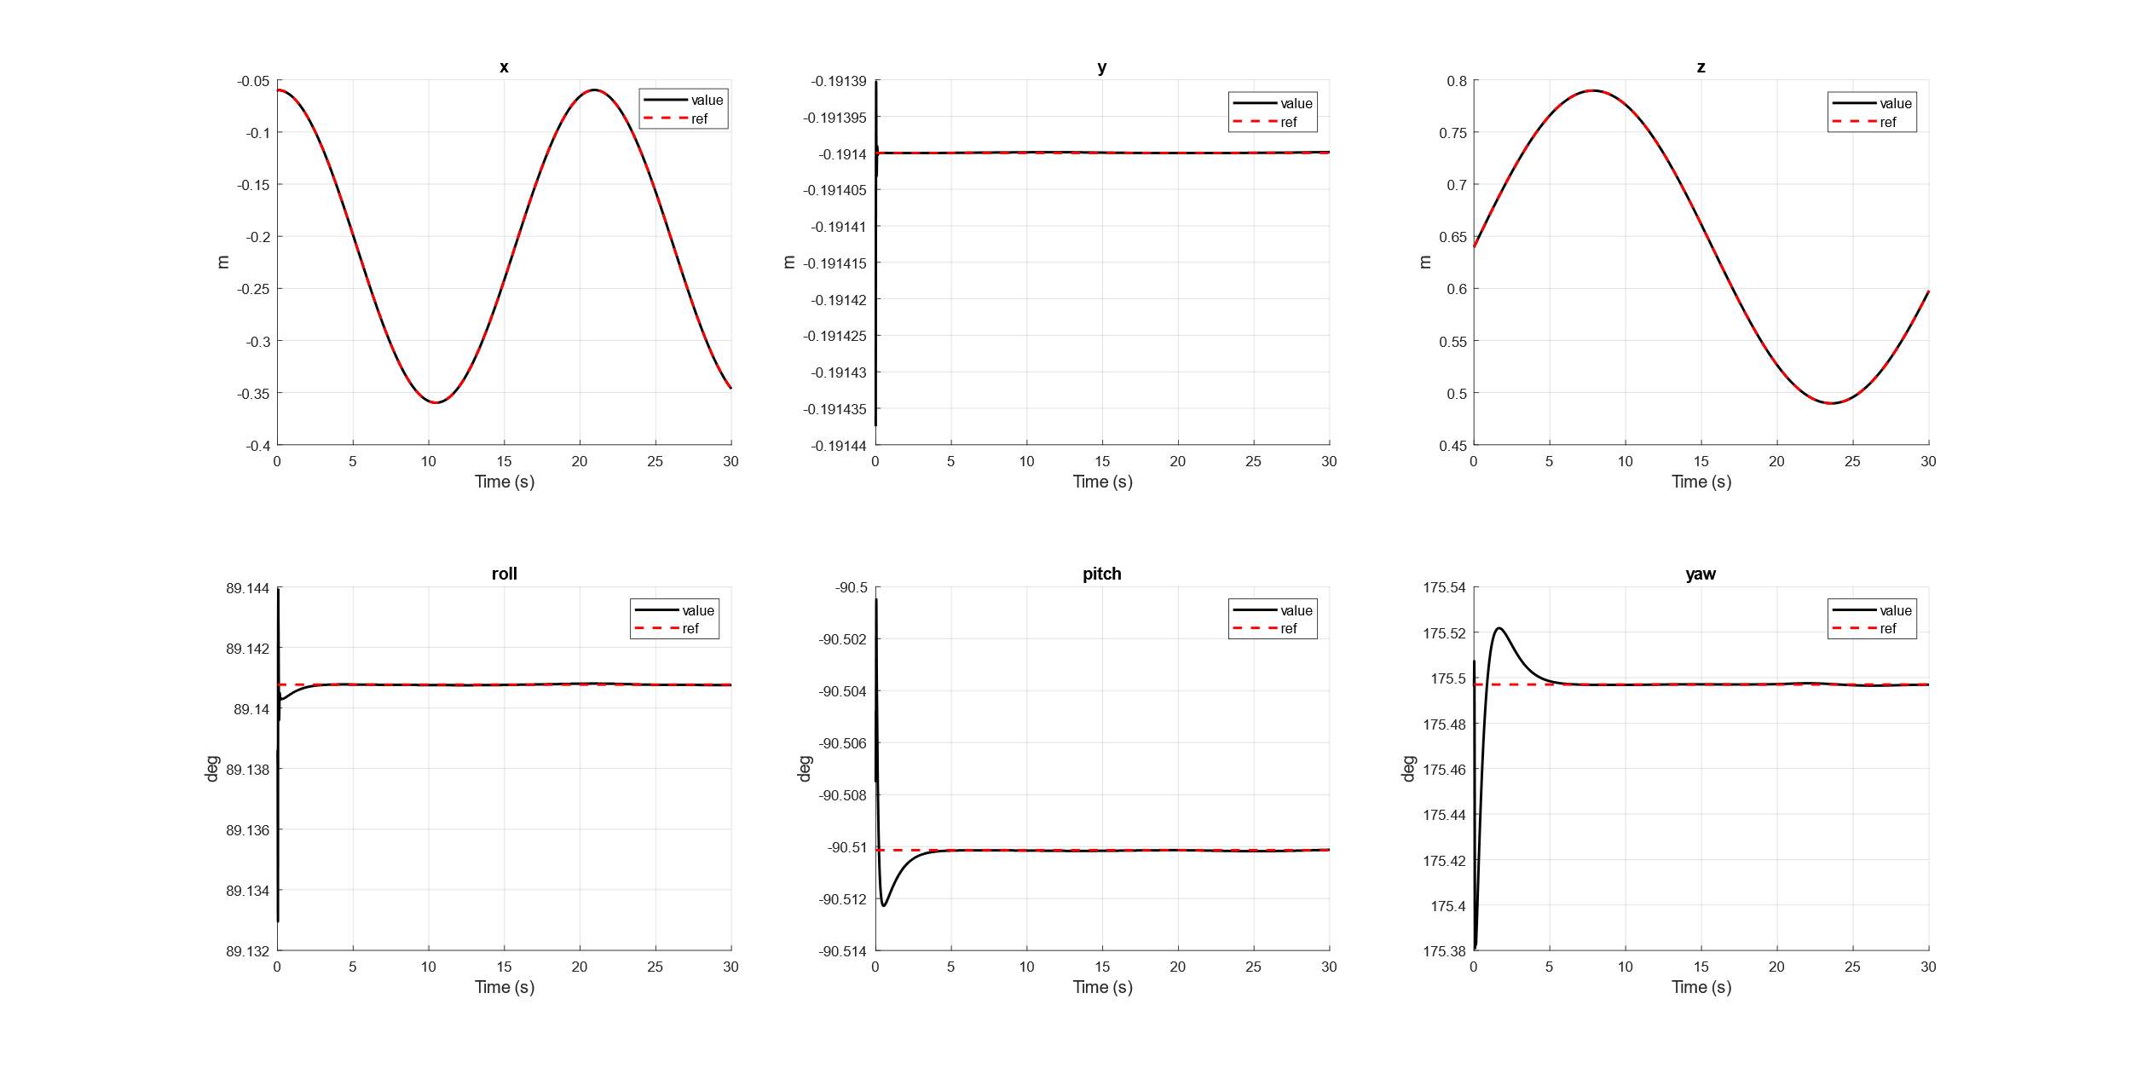
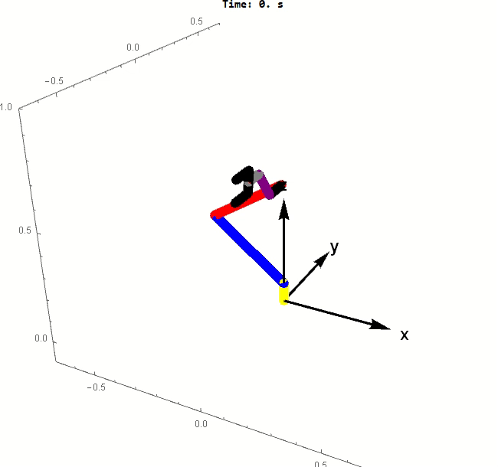
Adaptive Backstepping - Results

Slide 21
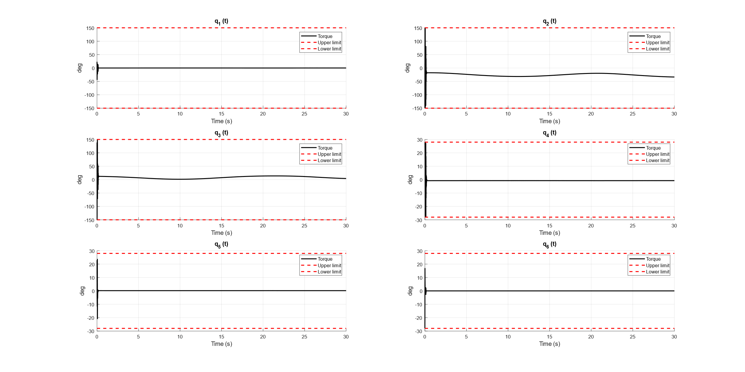
Adaptive Backstepping - Torques

Slide 22
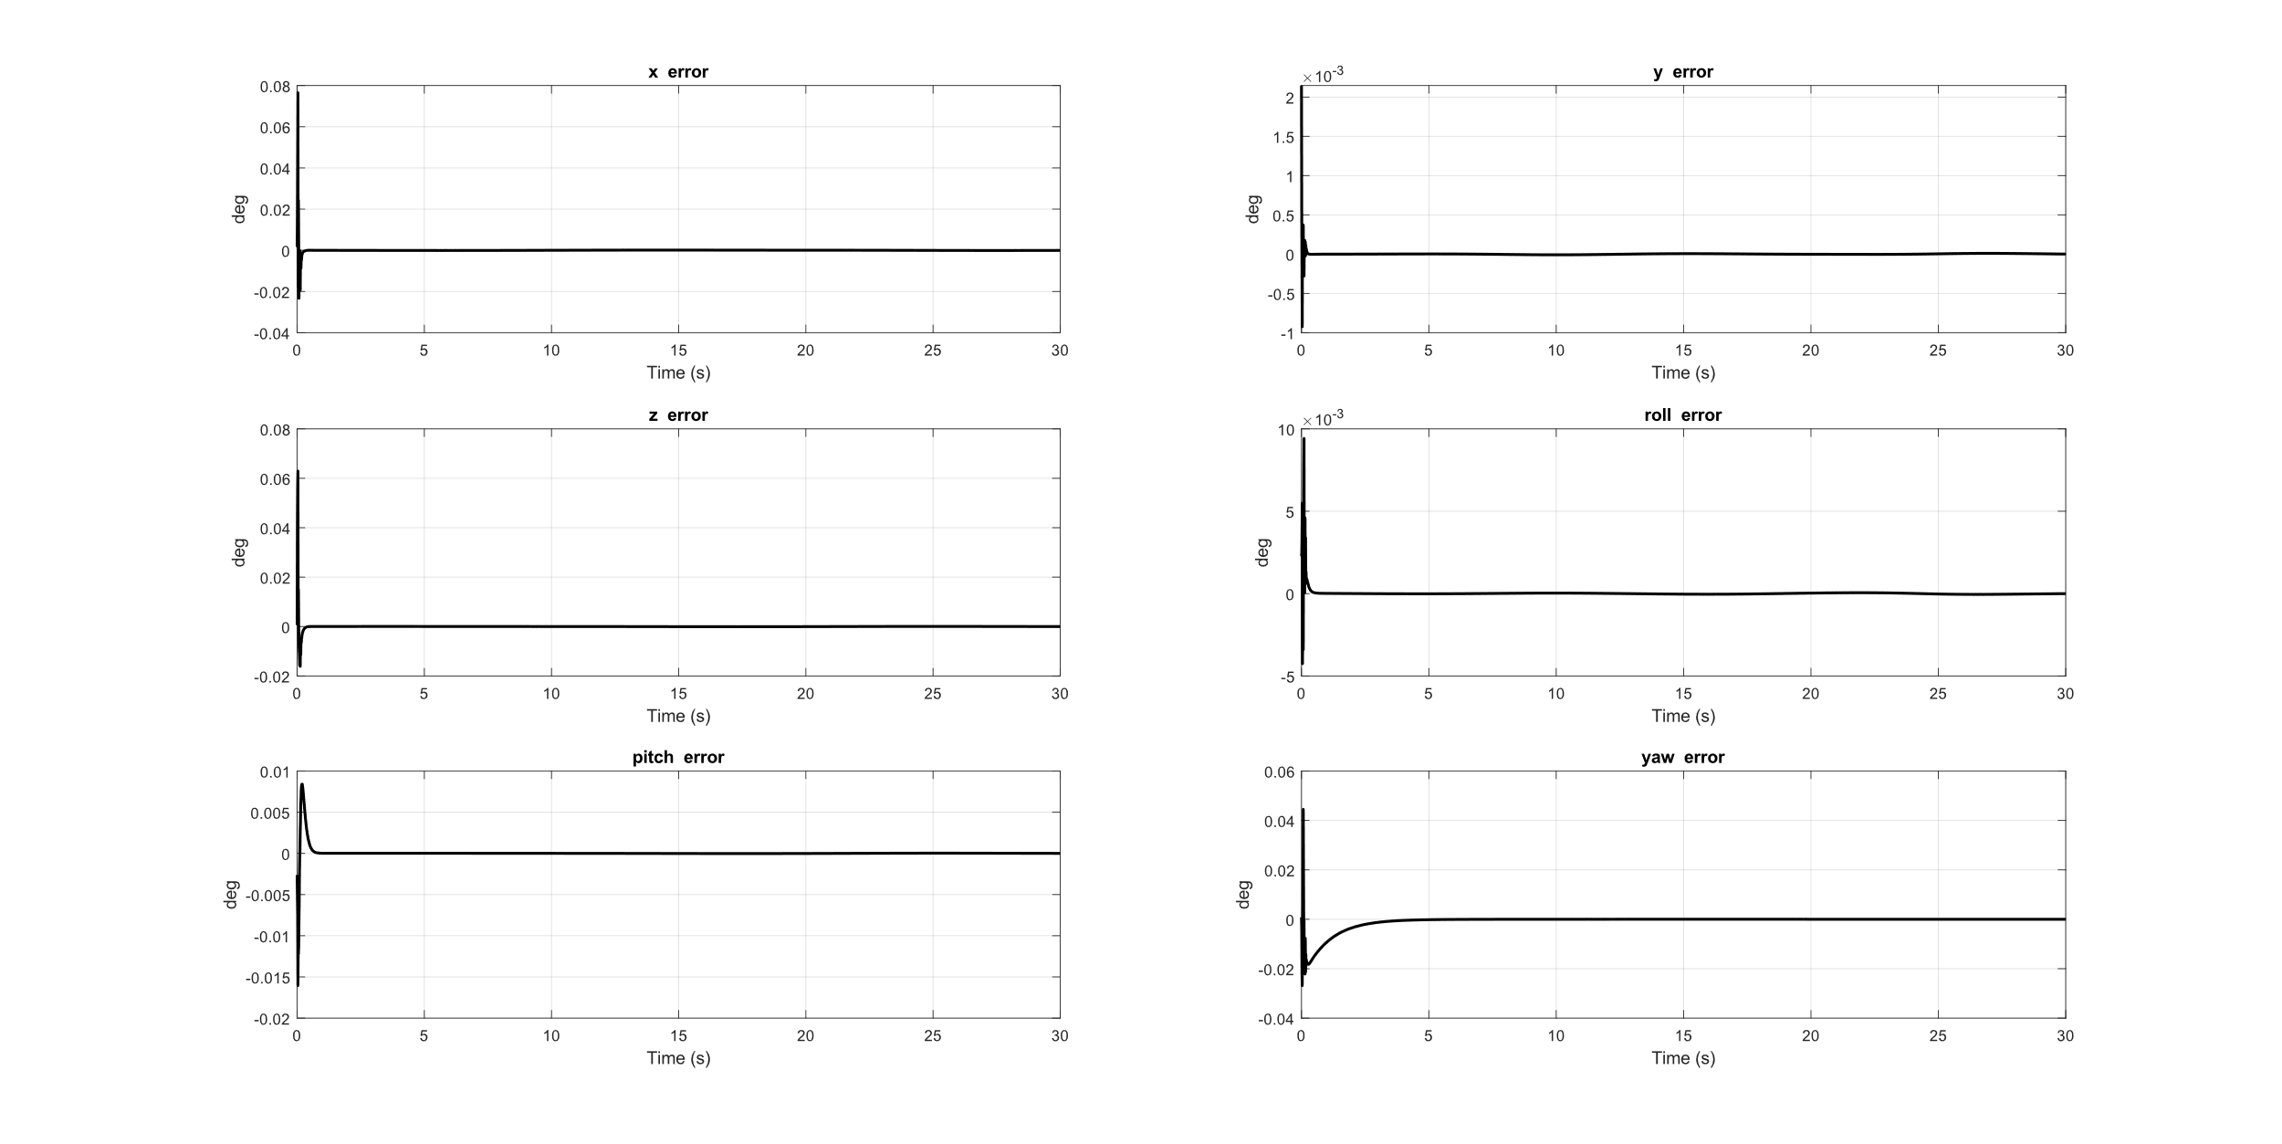
Adaptive Backstepping - Tracking Errors

Slide 23
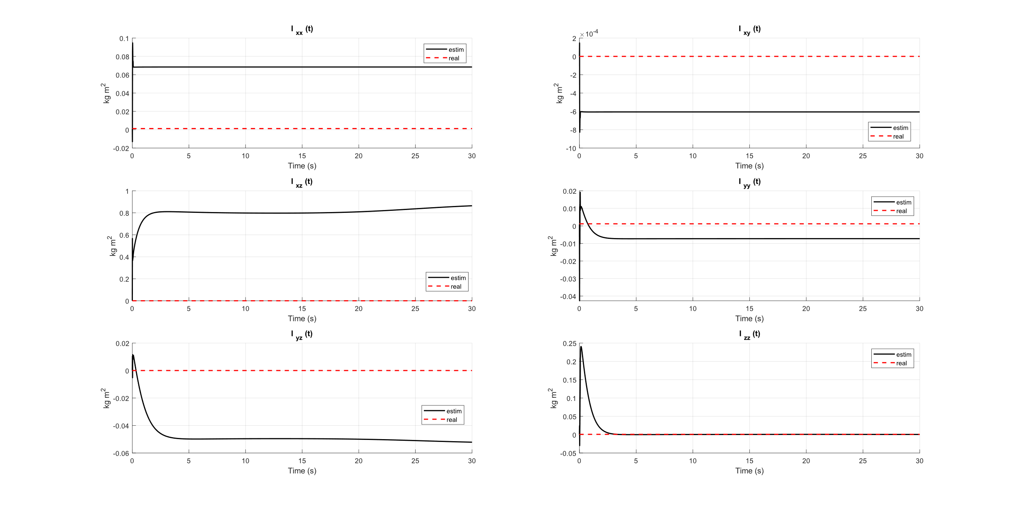
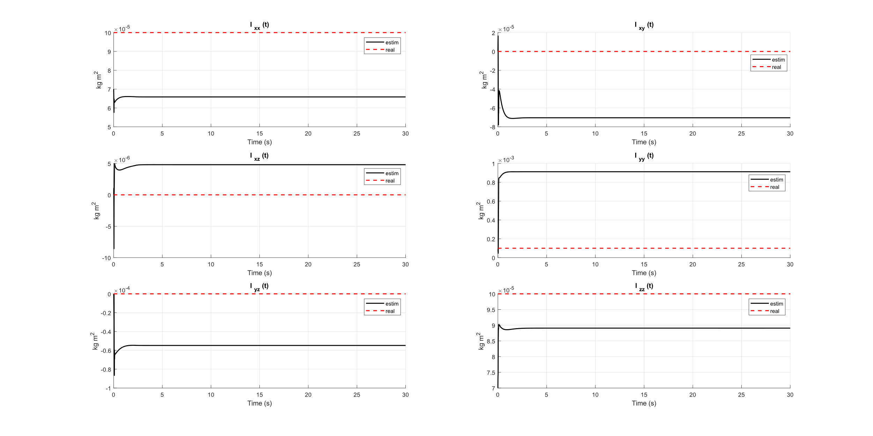
Estimated Intertias
We set, for each link, the initial inertia matrices at 30% less than the real value.

Slide 24
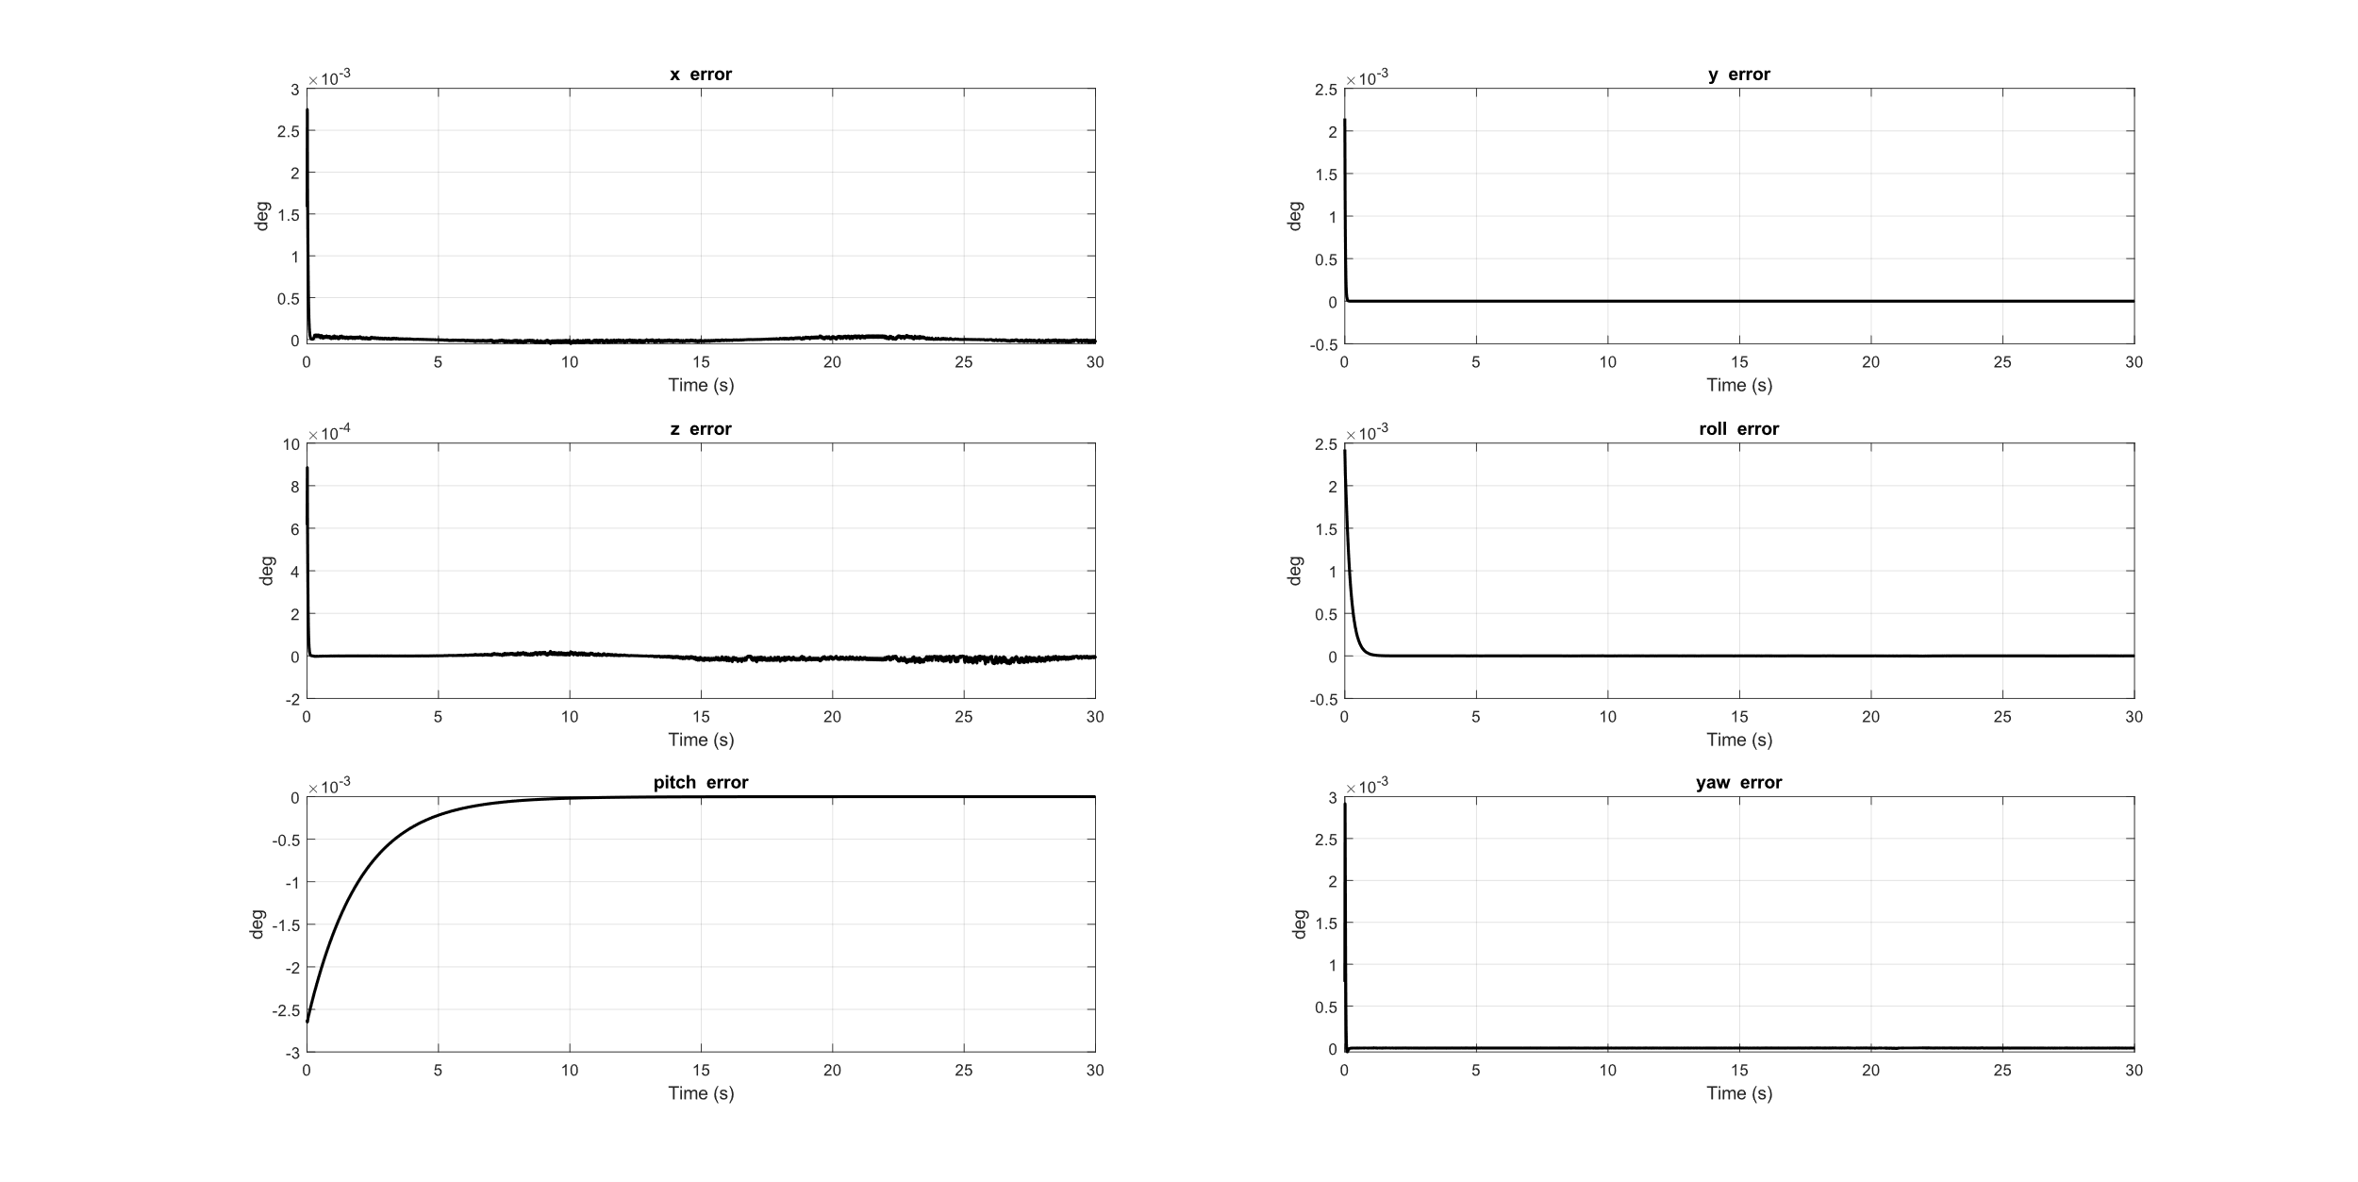
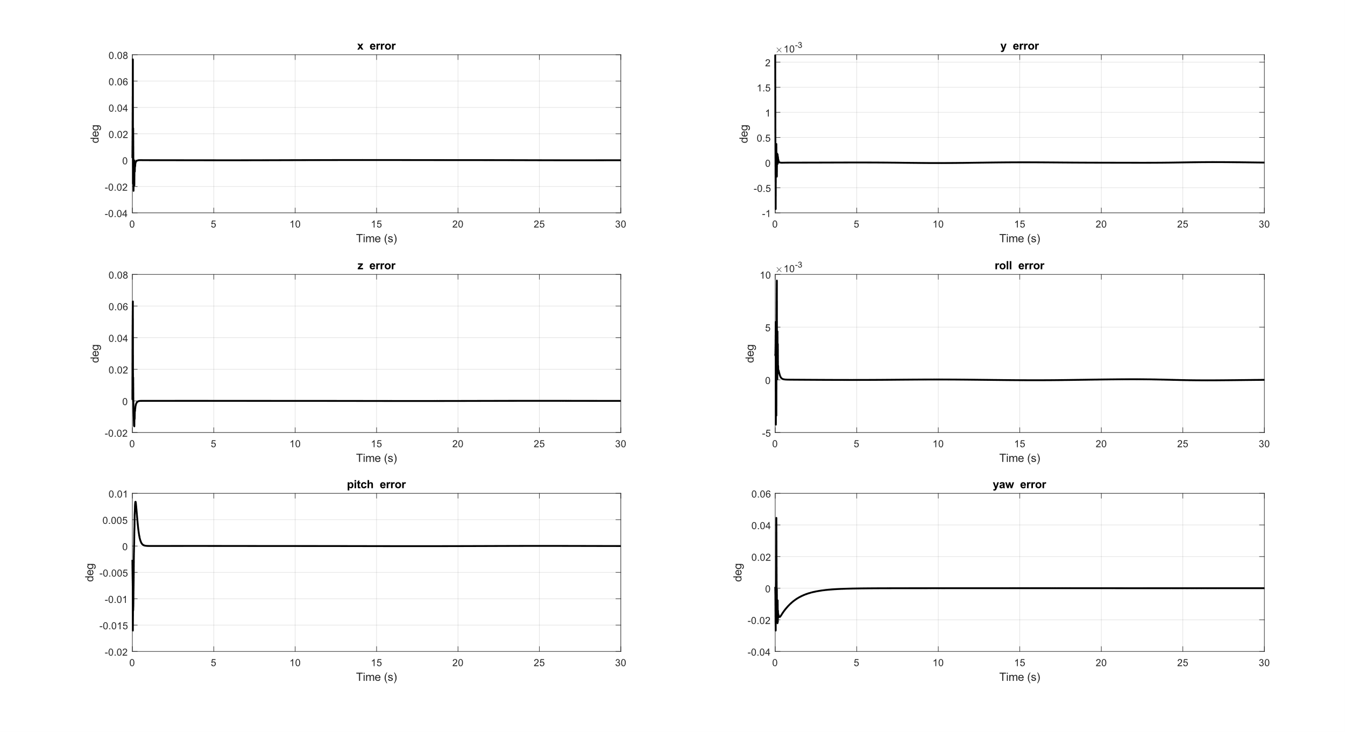
Backstepping vs Adaptive Backstepping
We set, for each link, the initial inertia matrices at 10% of their real values.
Tracking errors - Backstepping
Tracking errors - Adaptive Backstepping

Slide 25
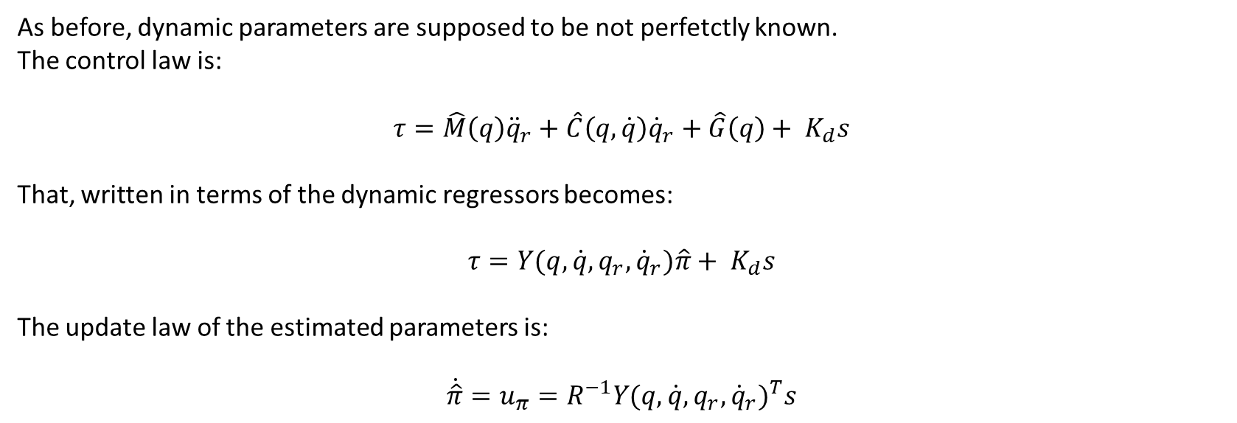
Li-Slotine
As before, dynamic parameters are supposed to be not perfetctly known.
The control law is:
$$τ=\hat{M}\left(q\right){\ddot{q}}_{r}+\hat{C}\left(q,\dot{q}\right){\dot{q}}_{r}+\hat{G}\left(q\right)+ K_{d}s$$
That, written in terms of the dynamic regressors becomes:
$$τ=Y(q,\dot{q},q_{r},{\dot{q}}_{r})\hat{π}+ K_{d}s$$
The update law of the estimated parameters is:
$$\dot{\hat{π}}=u_{π}=R^{−1}{Y(q,\dot{q},q_{r},{\dot{q}}_{r})}^{T}s$$

Slide 26
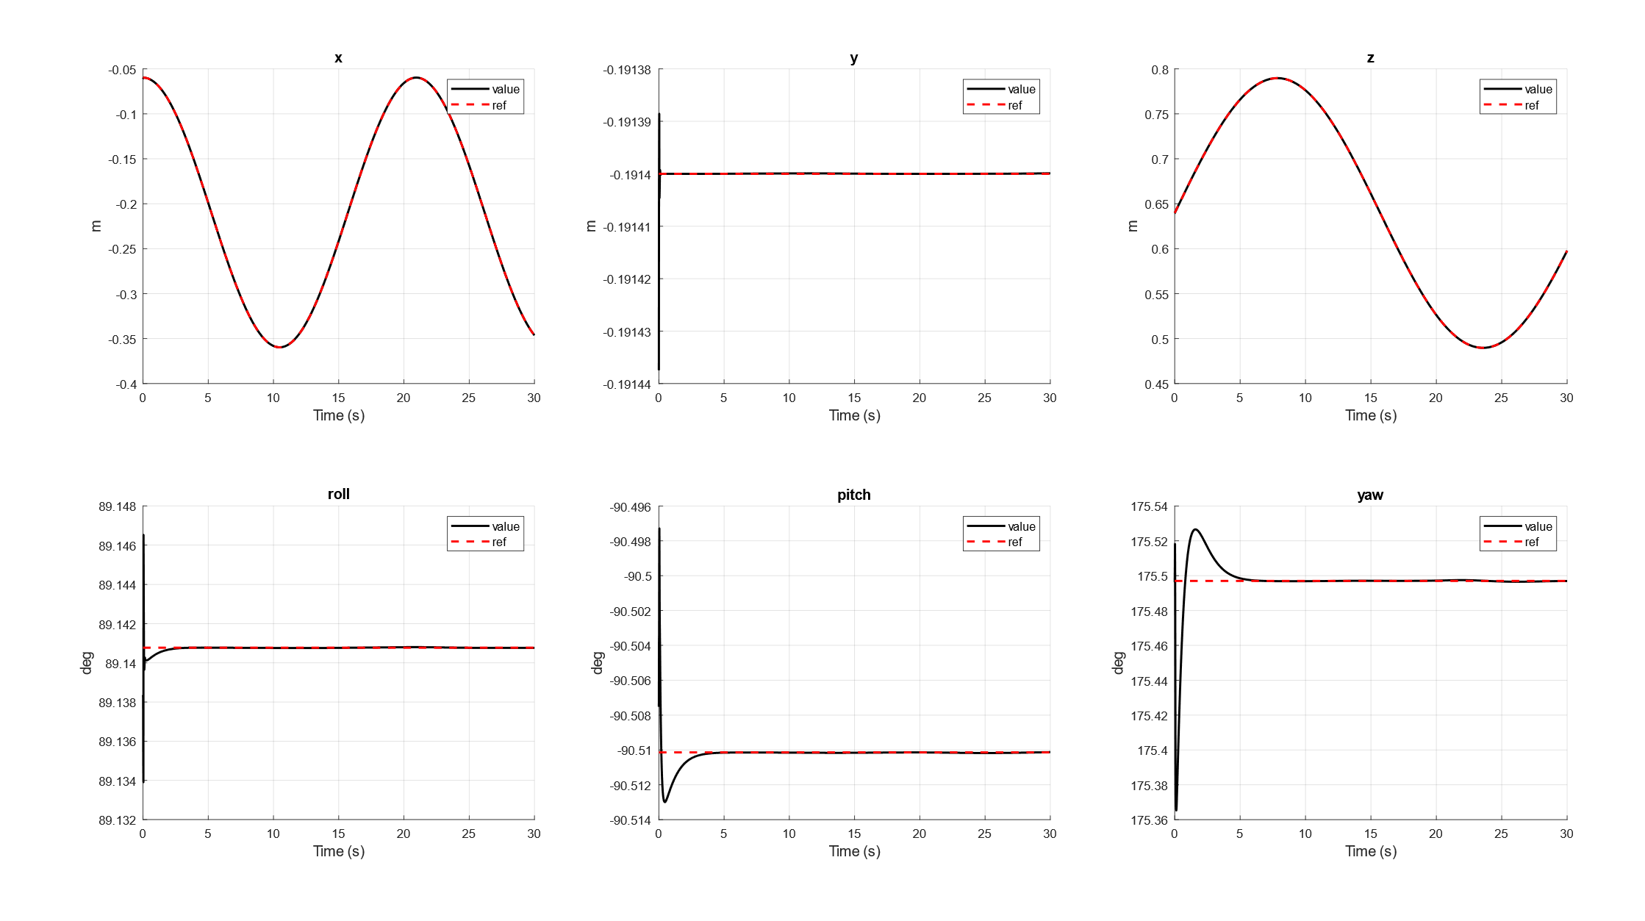
Li-Slotine - Results

Slide 27
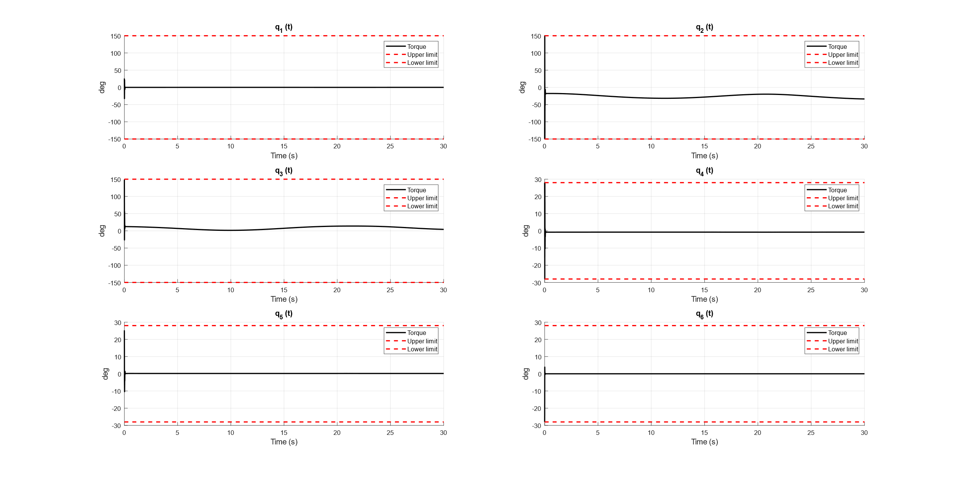
Li-Slotine - Torques

Slide 28
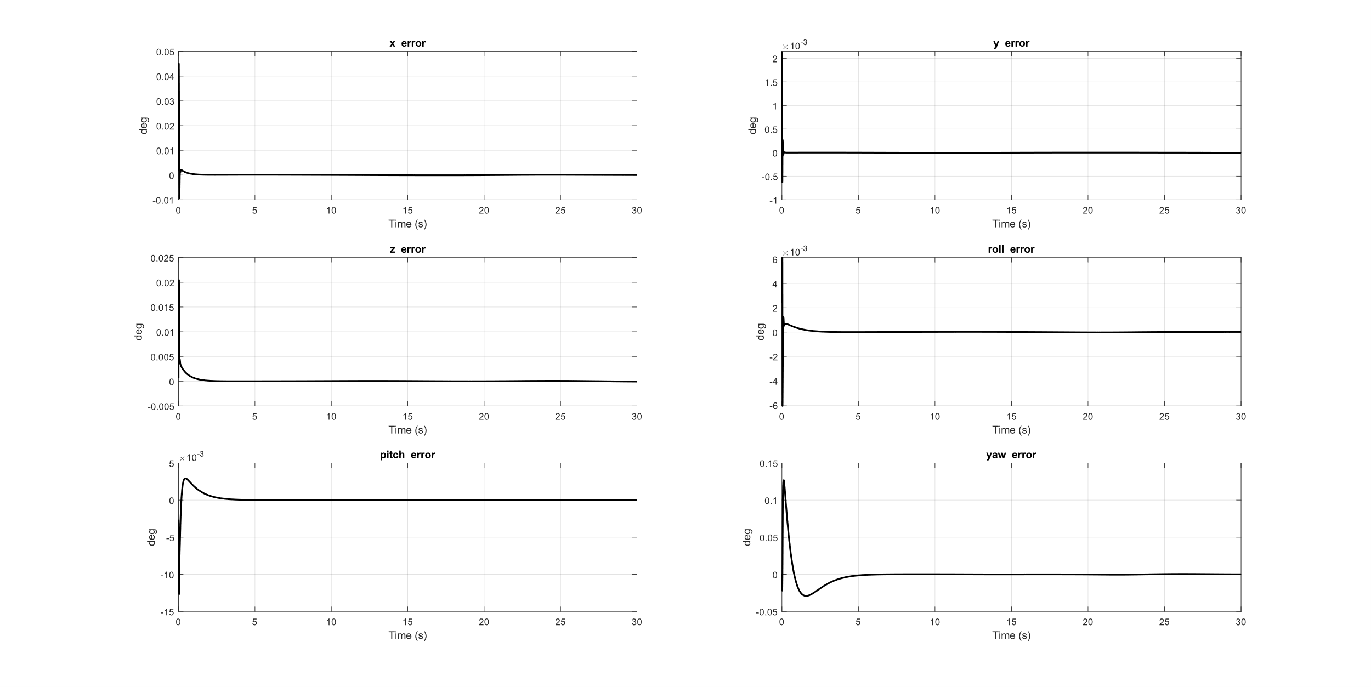
Li-Slotine – Tracking Errors

Slide 29
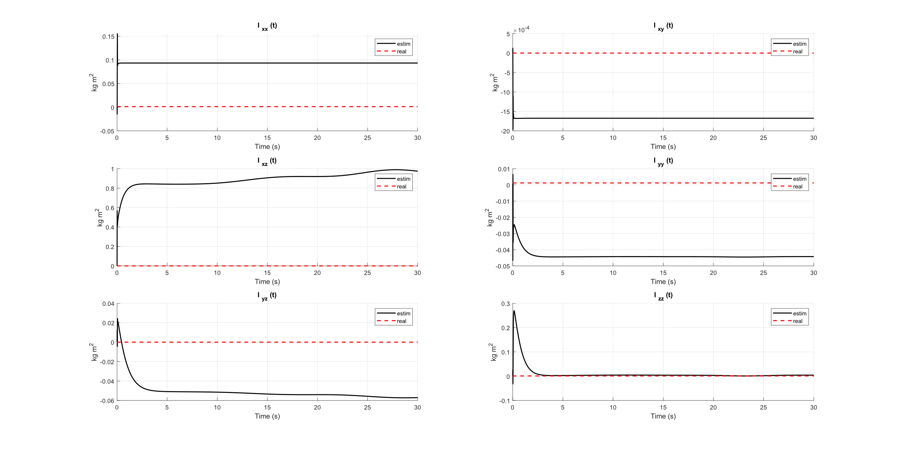
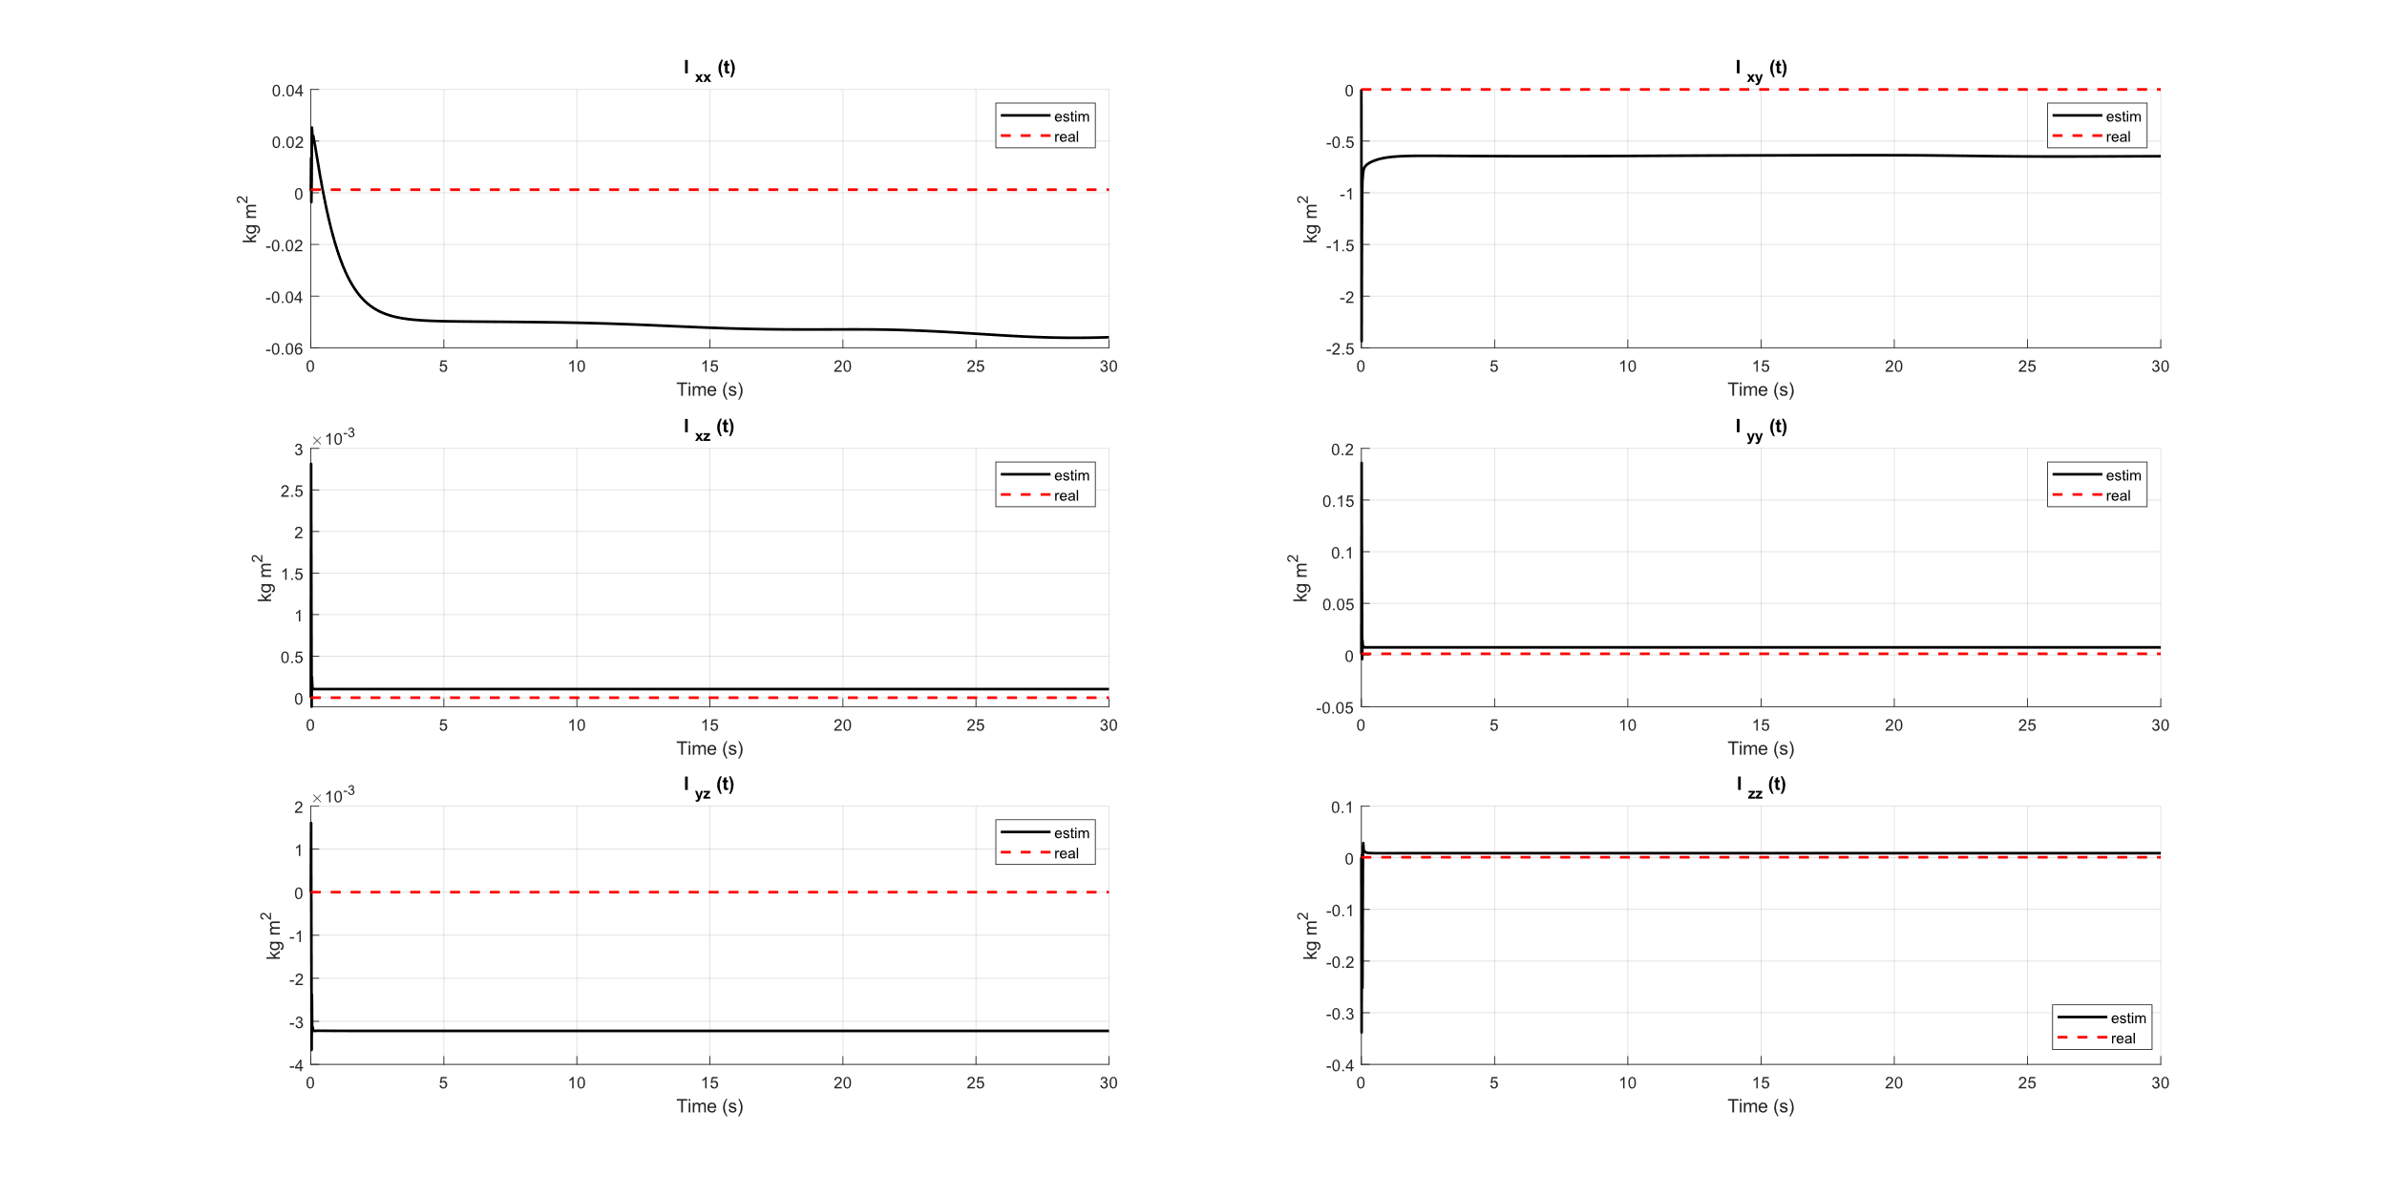
Estimated Intertias
We set, for each link, the initial inertia matricies at 30% less than the real value.

Slide 30
Li Slotine vs Adaptive Backstepping
We set, for each link, the initial inertia matrices at 10% of their real values.
Tracking errors - Li Slotine
Tracking errors - Adaptive Backstepping

Slide 31
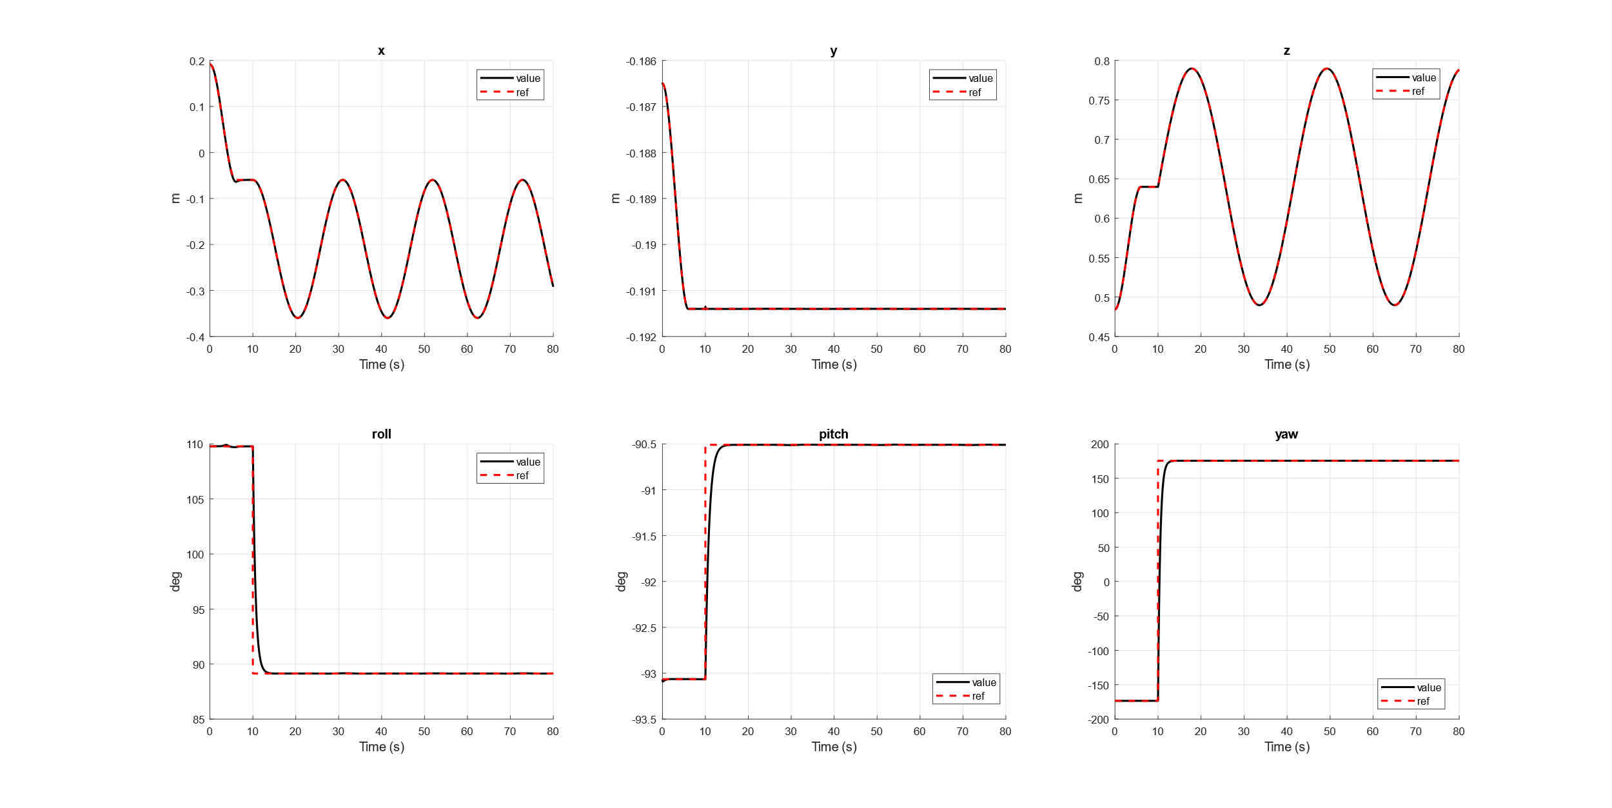
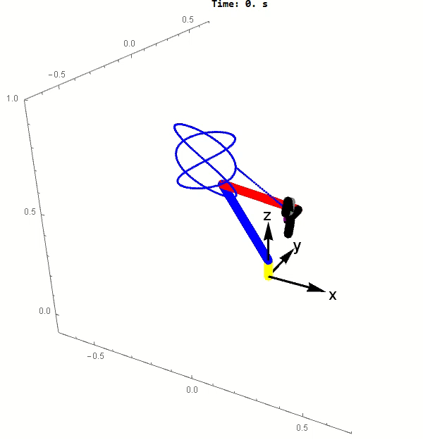
Changing Initial Conditions - Example
Just as an example, here is the Li-Slotine control starting away from the desired trajectory

Slide 32
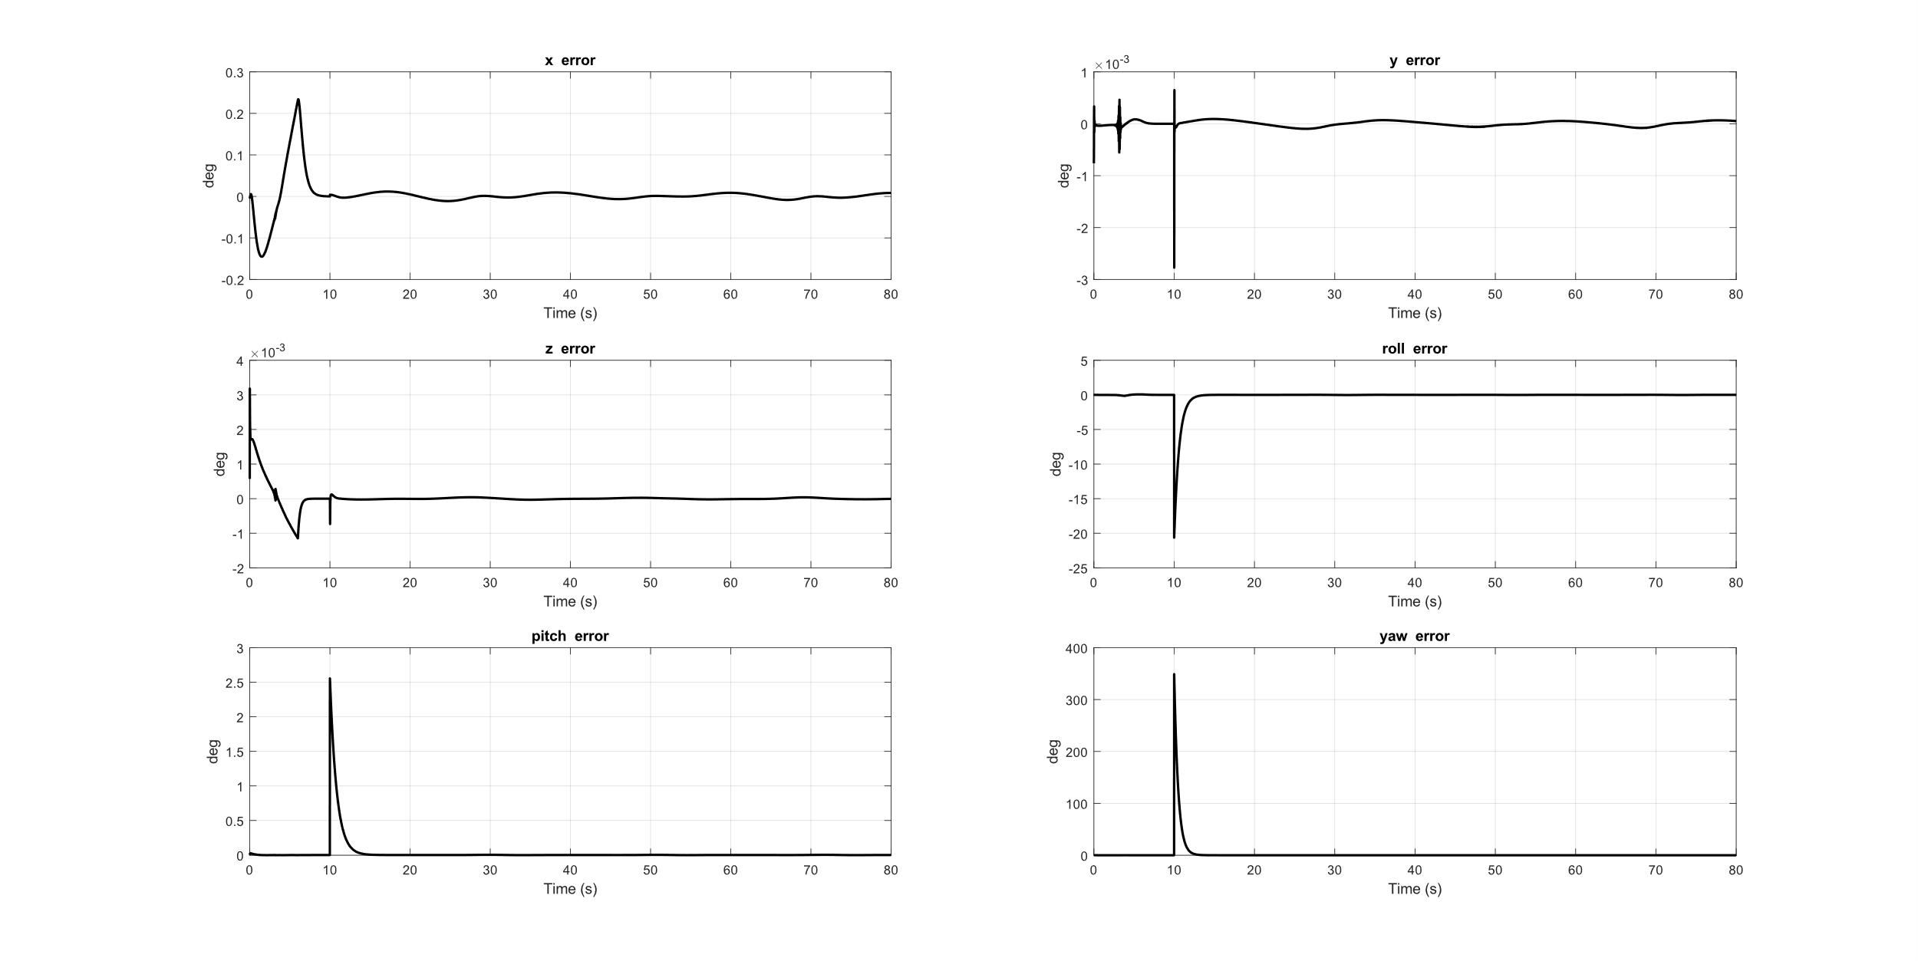
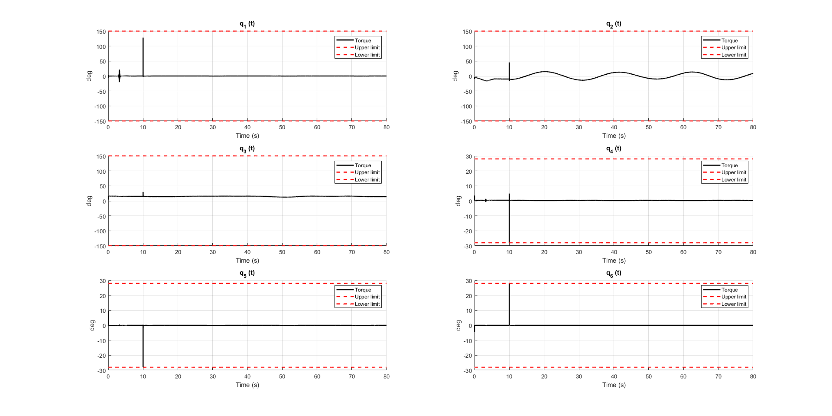
Changing Initial Conditions - Example
Errors (left figure) and required torques (right figure) grow at the 10th second because the references change, but all the errors still converge.

Slide 33
Tavola 1
Non-linear controls

